Slide 3
Agenda
9am – 12pm: (breaks dependent on venue logistics)
Overview of SeaDAS Visualization (Slides) - (15 to 20 minutes)
Visualization Quick Demo (very brief and basic: show easy default features) – (2 to 5 minutes) – save questions in-depth demo
Overview of SeaDAS Science Processors and Data (30 to 45 minutes)
Science Processors Quick Demo (very brief and basic: where the tools are, etc.) (2 to 5 minutes) – save questions in-depth demo
Setup and Docker Image (20 to 30 minutes) - Aynur
Break ?
Visualization Demo (In-depth) (60 to 90 minutes)
There’s too many tools to cover them all so audience questions will partly guide what’s covered
Questions encouraged as we go
Following along on your machine is optional
(but we will be going at a quick pace – unless you want us to slow down)
1:30pm: We will be available for setup help (30 minutes)
2pm – 5pm: (breaks dependent on venue logistics)
Science Processors Demo (In-depth) (60 to 90 minutes)
Note: Workflow 1 and Workflow 2 (may not precisely match slides – or we can just use the slide instead of live demo)
Tools for PACE (but not limited to PACE) – (15 to 20 minutes) - Bing
Break?
Science Processors and Visualization Demo (continued) (45 to 60 minutes)
Things we didn’t get to earlier
Q & A
User prompted demos of any of the tools
GPT (if you want it) - Bing
Docker Image more in-depth (if you want it) - Aynur
Tuesday – Thursday:
We will be available at the SeaDAS Poster

Slide 4
SeaDAS Training
Overview

Slide 5
SeaDAS Supported Missions
SeaDAS
AVHRR
CZCS
ETM+ Landsat7
GOCI
HawkEye
HICO
MERIS
MODIS Aqua
MODIS Terra
MOS
MSI Sentinel 2A
MSI Sentinel 2B
OCI PACE**
OCM1
OCM2
OCTS
OLCI Sentinel 3A
OLCI Sentinel 3B
OLI Landsat 8
OLI Landsat 9
OSMI
SeaWiFS
TM Landsat 5
VIIRS Suomi NPP
VIIRS NOAA20
VIIRS NOAA21
Polarimeters:
HARP2 PACE*
MISR
SPEXone PACE*
Airborne Sensors:
AVIRIS
PRISM
(Sea, earth and atmosphere Data Analysis System)
NASA Software for the processing, visualization and analysis of Earth science data
developed by NASA's Ocean Biology Processing Group (OBPG)
OB.DAAC (Ocean Biology Distributed Active Archive Center) is a NASA EOSDIS DAAC
https://seadas.gsfc.nasa.gov
https://oceancolor.gsfc.nasa.gov
https://www.earthdata.nasa.gov/eosdis/daacs/obdaac
EOSDIS - Earth Observing System Data and Information System
* Limited support
* Planned (limited support)
** Planned full support

Slide 6
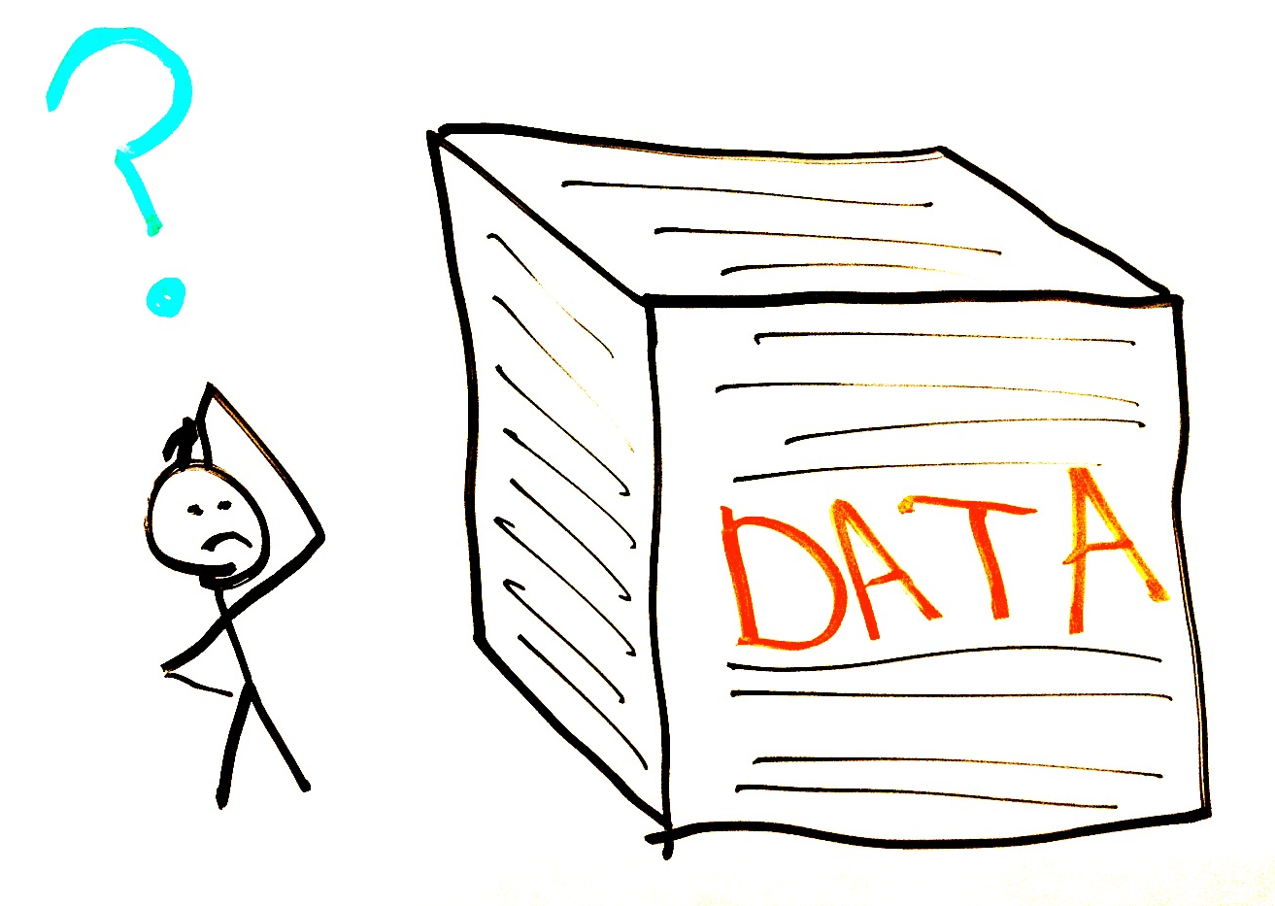
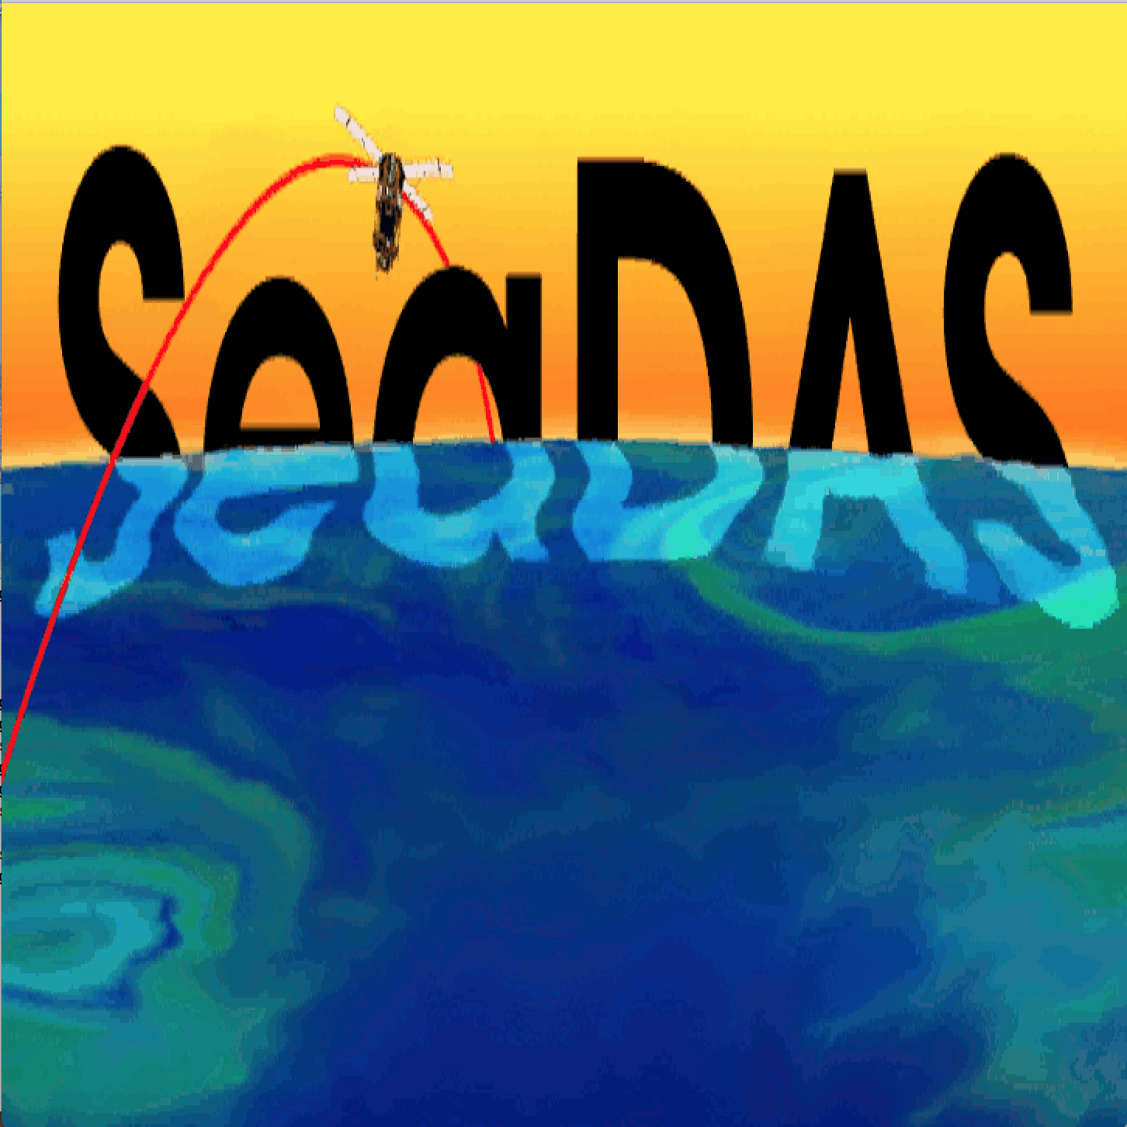
SeaDAS Historical Perspective
1987 “System Concept for Wide Field-of-View Observation of Ocean Phenomena From Space”
Specifications report outlines SeaWiFS as an improved oceancolor sensor
Nimbus-7 Coastal Zone Color Scanner (CZCS) had ceased operating (Oct 1978 – June 1986)
Early 1990s SeaDAS Vision
Provide user community with tools to work with the satellite data
Visualization & Analysis of distributed NASA products: levels 1, 2 and 3
Processing: Identically reproduce all standard NASA products: levels 1, 2 and 3
Continually evolve to keep up with technology
1994 July: SeaDAS Beta release
SeaDAS (SeaWiFS Data Analysis System)
1997 Sep: SeaDAS release (version 3.0B3) : supports SeaWiFS operations
2012: SeaDAS integrates BEAM GUI interface software
2021: SeaDAS integrates SNAP GUI interface software
2023: Supports 24 missions (version 8.3.0)
SeaDAS (Sea, earth and atmosphere Data Analysis System)

Slide 7
SeaDAS User Software
General Image Analysis Tools

Slide 8
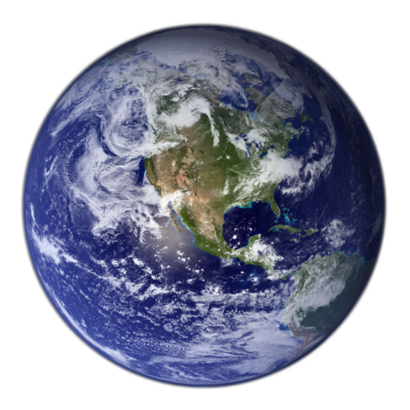
SeaDAS User Software: General Image Analysis Tools
Satellite
SeaDAS
General Image
Analysis Tools
Imagery
Masking
Mapping
Aggregation
Algorithms
Analysis
Statistics
SeaDAS Science
Processing Tools
Level-0 Files*
Level-1A Files*
Level-1B Files*
Receiving Station
Data Provider
Geo Files*
Geo Files*
Level-1B Files*
Level-0 Files*
Level-1A Files*
Level-1B Files*
Level-2 Files*
Level-2 Files*
Level-3 Binned Files
Level-3 Binned Files
Level-3 Mapped Files
Level-3 Mapped Files
OB.DAAC
ODPS
Ancillary Files
User
Ancillary Files
Ancillary Sources
* Mission dependent

Slide 9
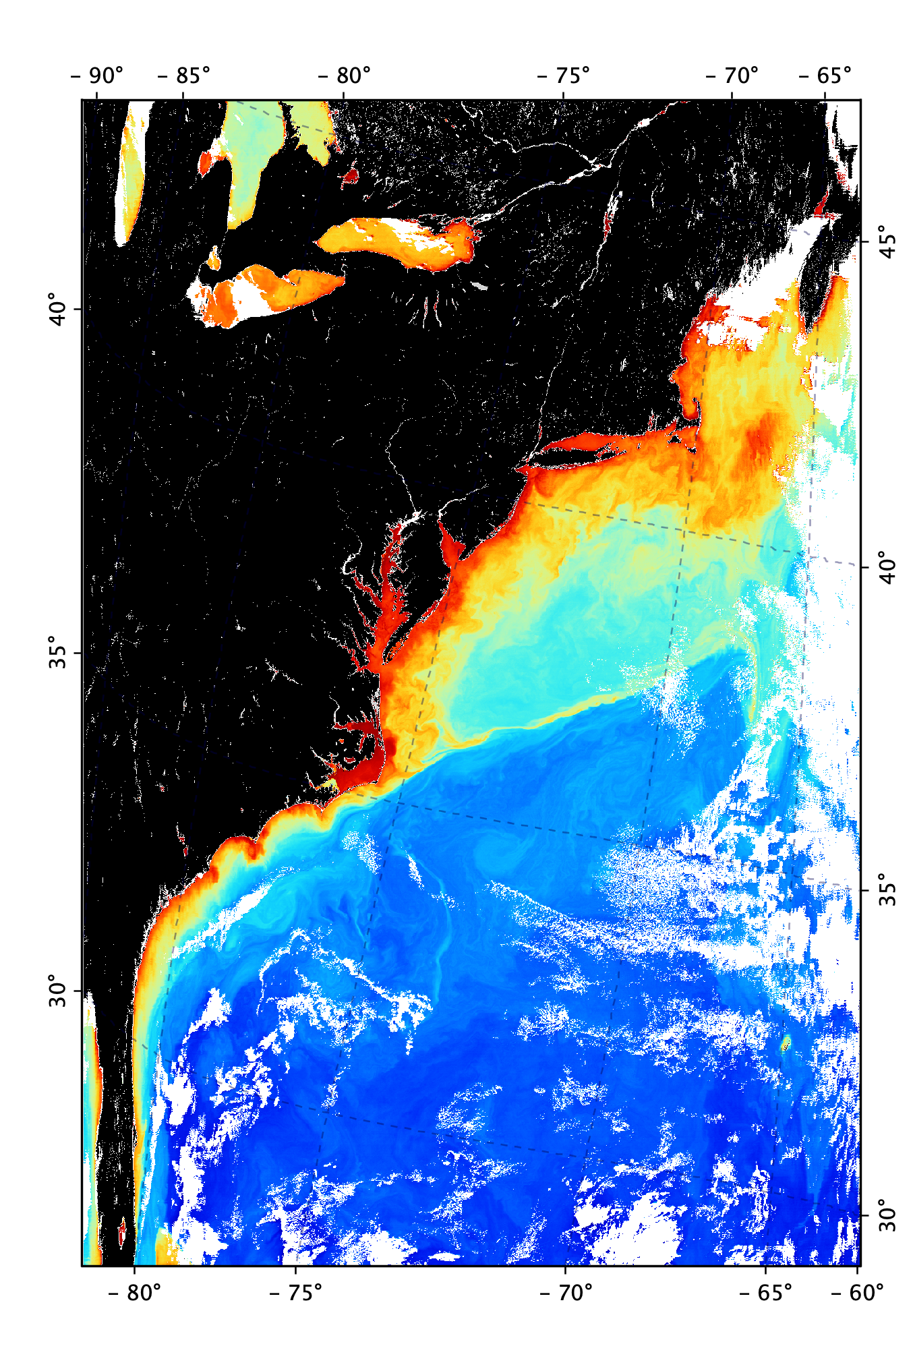
SeaDAS User Software: General Image Analysis Tools
Level-2 File
SeaDAS
General Image
Analysis Tools
Imagery
Masking
Mapping
Aggregation
Algorithms
Analysis
Statistics
User

Slide 10
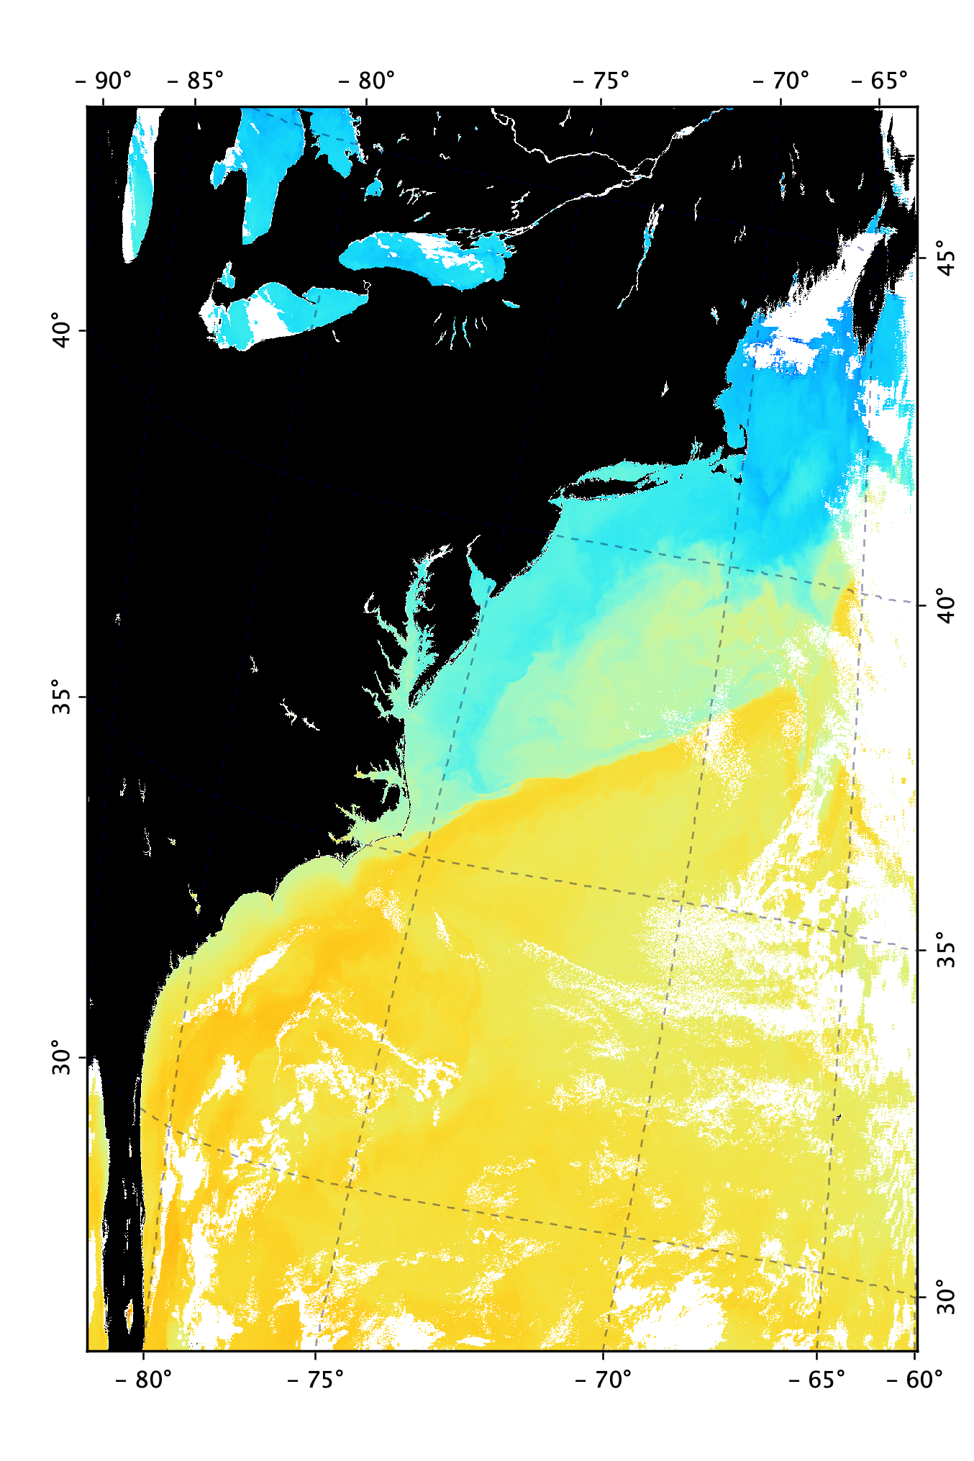
SeaDAS User Software: General Image Analysis Tools
Level-2 File
SeaDAS
General Image
Analysis Tools
Imagery
Masking
Mapping
Aggregation
Algorithms
Analysis
Statistics
User

Slide 11
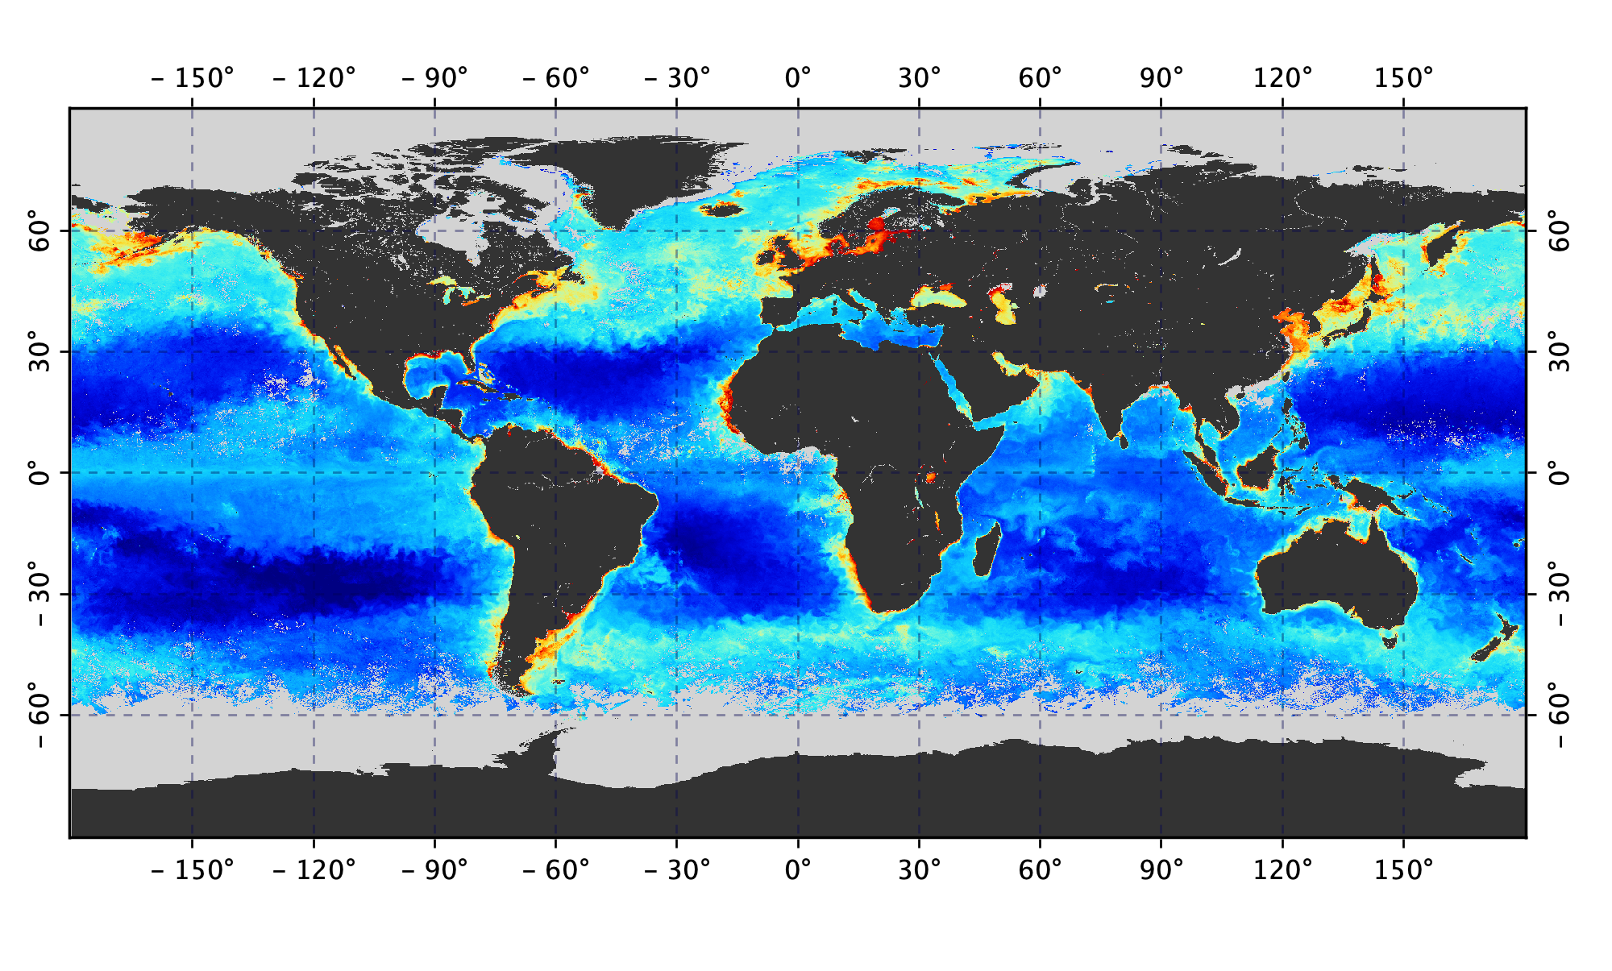
SeaDAS User Software: General Image Analysis Tools
Level-3 Mapped File
SeaDAS
General Image
Analysis Tools
Imagery
Masking
Mapping
Aggregation
Algorithms
Analysis
Statistics
User

Slide 12
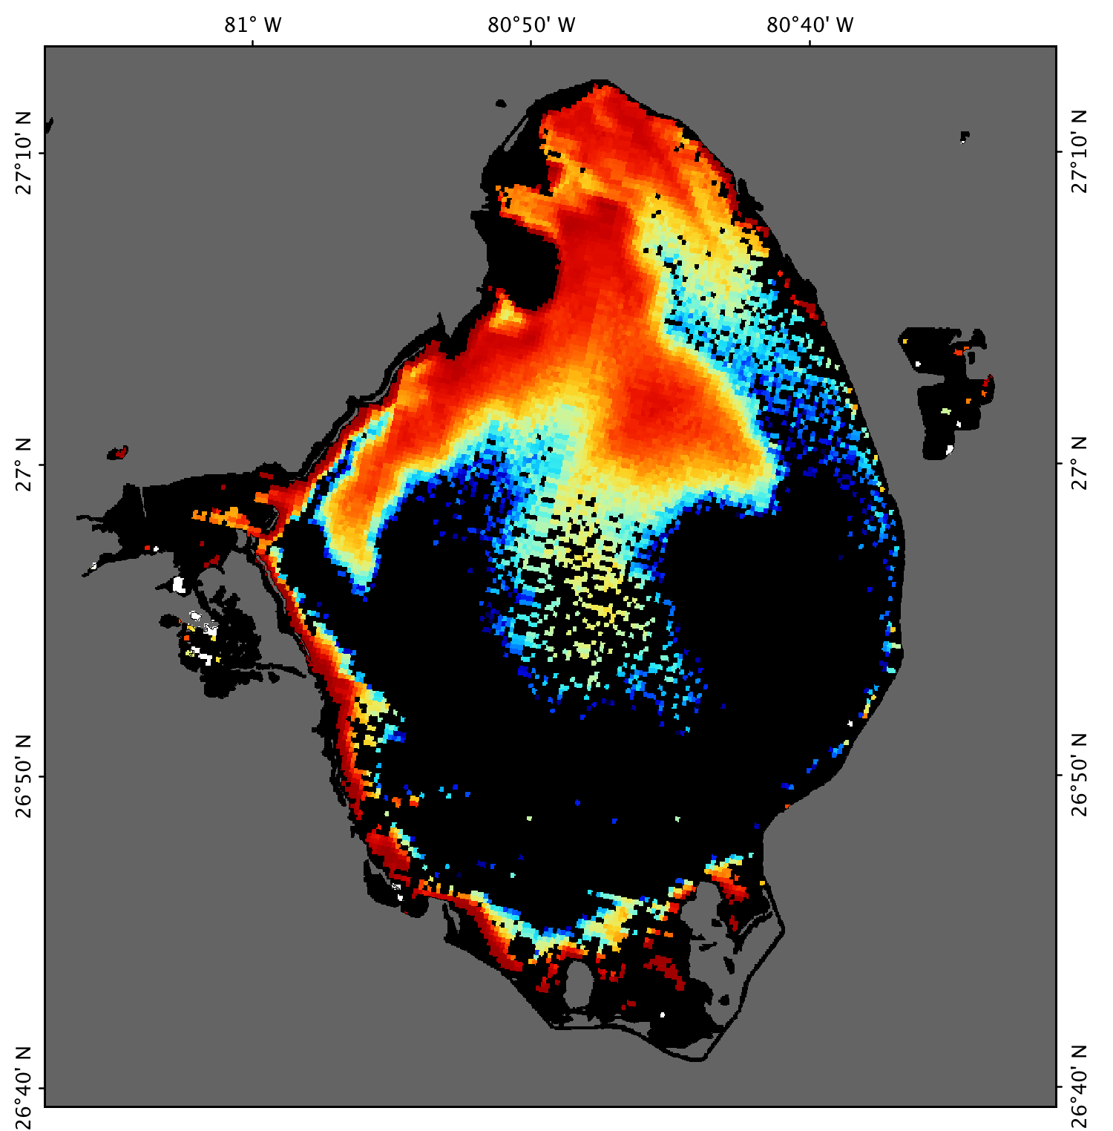
SeaDAS User Software: General Image Analysis Tools
Color Bar Custom Labels
SeaDAS
General Image
Analysis Tools
Imagery
Masking
Mapping
Aggregation
Algorithms
Analysis
Statistics
User
Lake Okeechobee June 22, 2011
Source data: MERIS M2011173153504

Slide 13
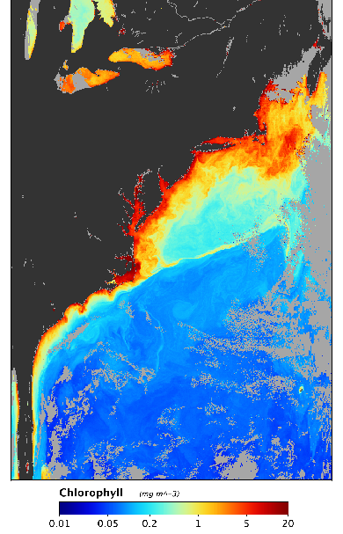
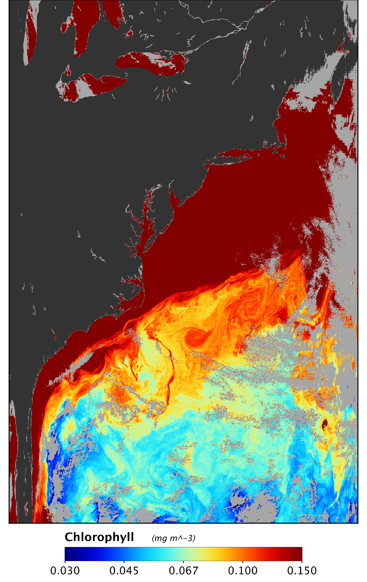
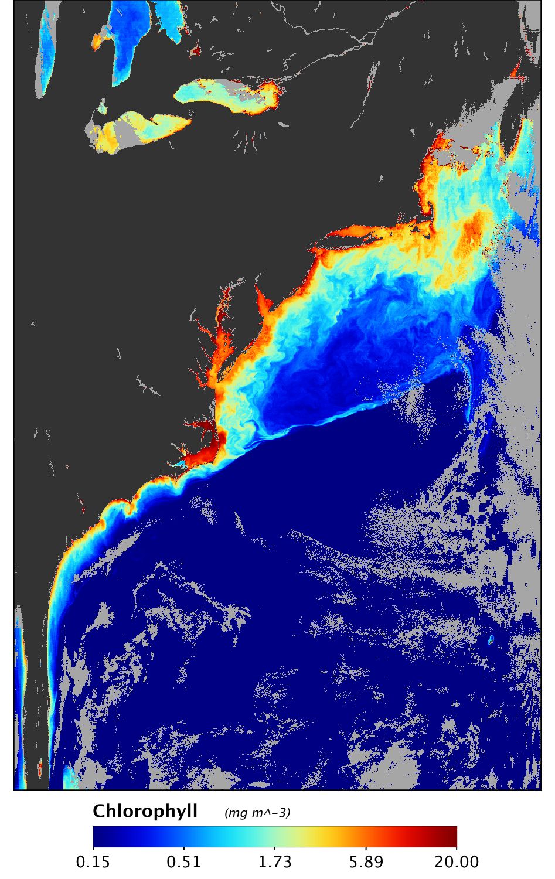
SeaDAS User Software: General Image Analysis Tools
Color Palette Range Settings
SeaDAS
General Image
Analysis Tools
Imagery
Masking
Mapping
Aggregation
Algorithms
Analysis
Statistics
User
Default
Low (oligotrophic)
High (eutrophic)

Slide 14
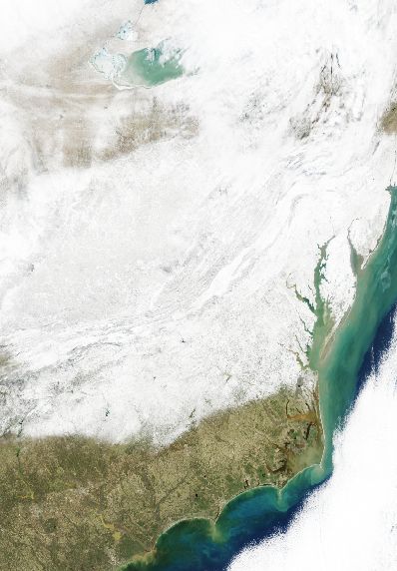
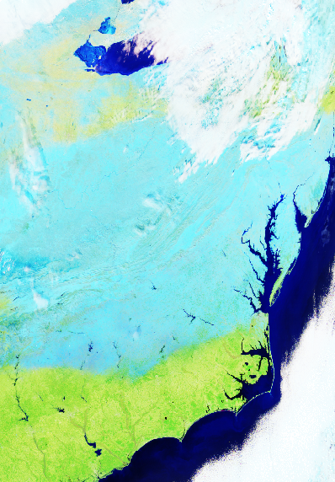
SeaDAS User Software: General Image Analysis Tools
Band Combinations RGB Imagery
SeaDAS
General Image
Analysis Tools
Imagery
Masking
Mapping
Aggregation
Algorithms
Analysis
Statistics
User
Pseudo True Color
R=645, G=555, B=469
Distinguish Ice, Snow, Clouds
R=2130, G=1240, B=469

Slide 15
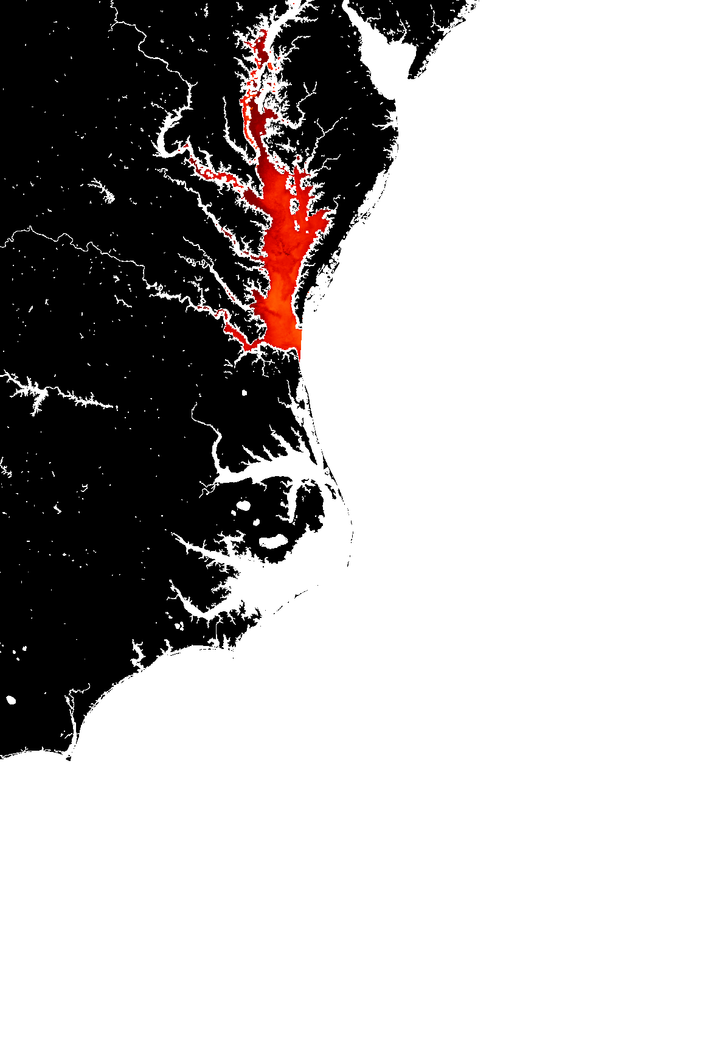
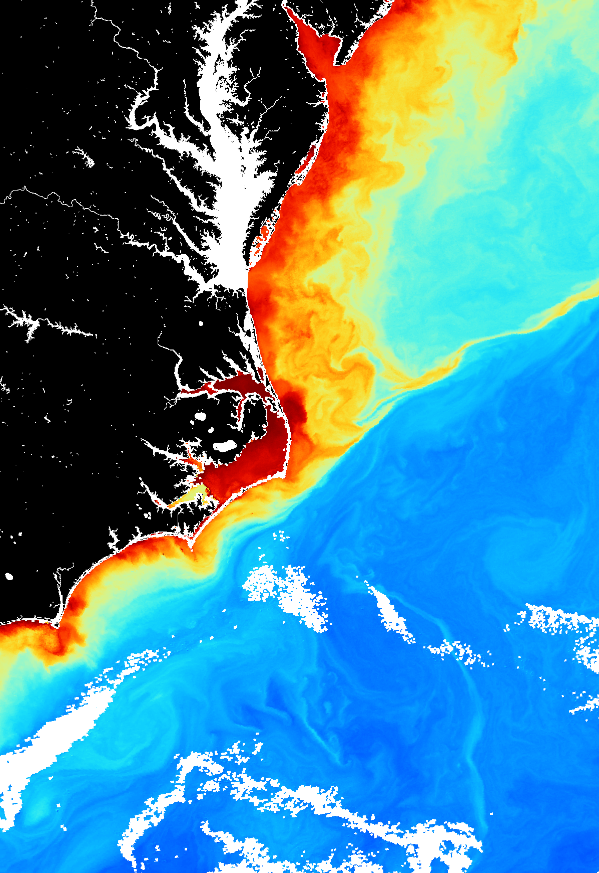
SeaDAS User Software: General Image Analysis Tools
Masking Regional Areas of Interest
SeaDAS
General Image
Analysis Tools
Imagery
Masking
Mapping
Aggregation
Algorithms
Analysis
Statistics
User

Slide 16
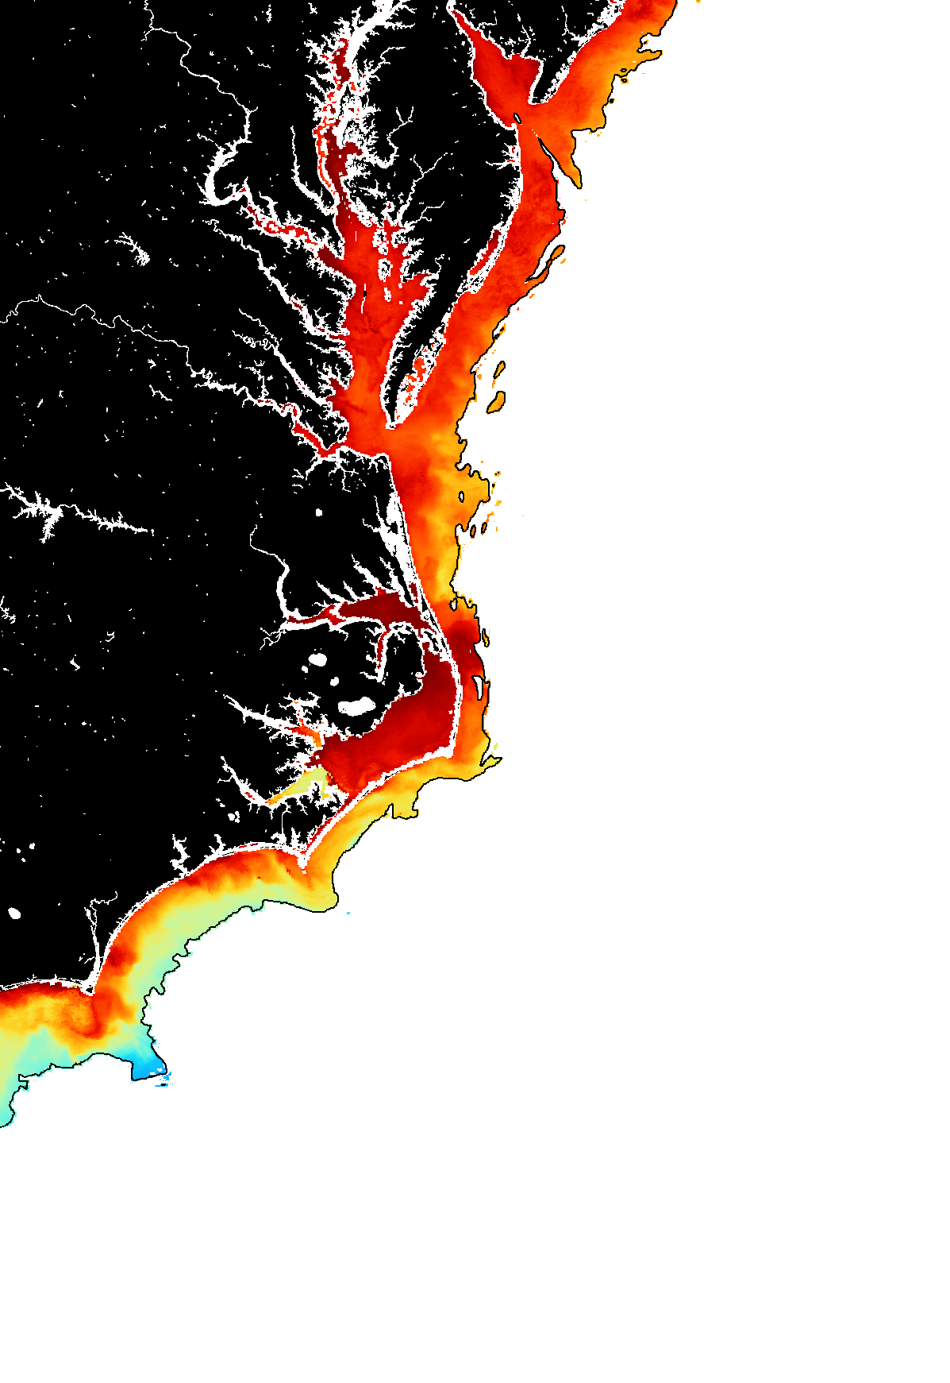
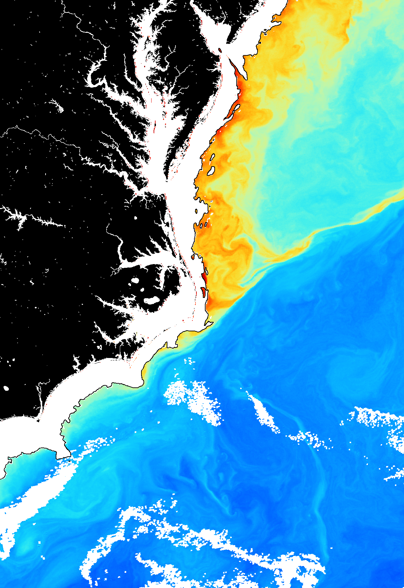
SeaDAS User Software: General Image Analysis Tools
Masking Water Depth (Bathymetry)
SeaDAS
General Image
Analysis Tools
Imagery
Masking
Mapping
Aggregation
Algorithms
Analysis
Statistics
User

Slide 17
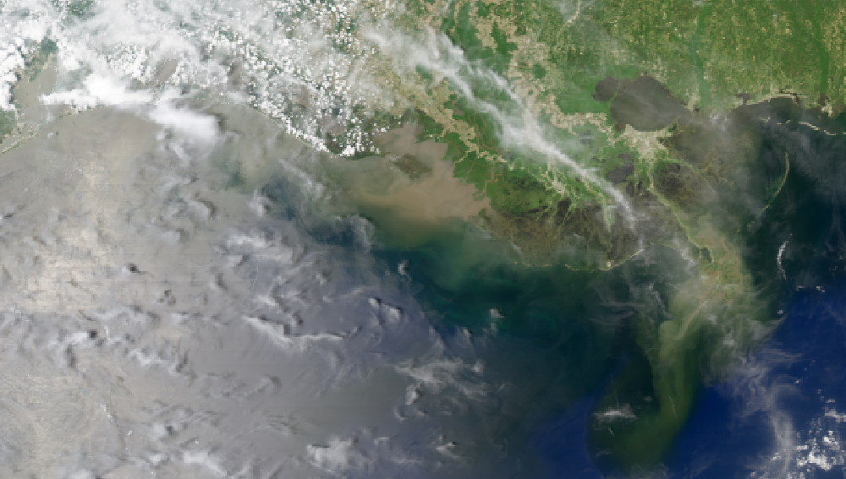
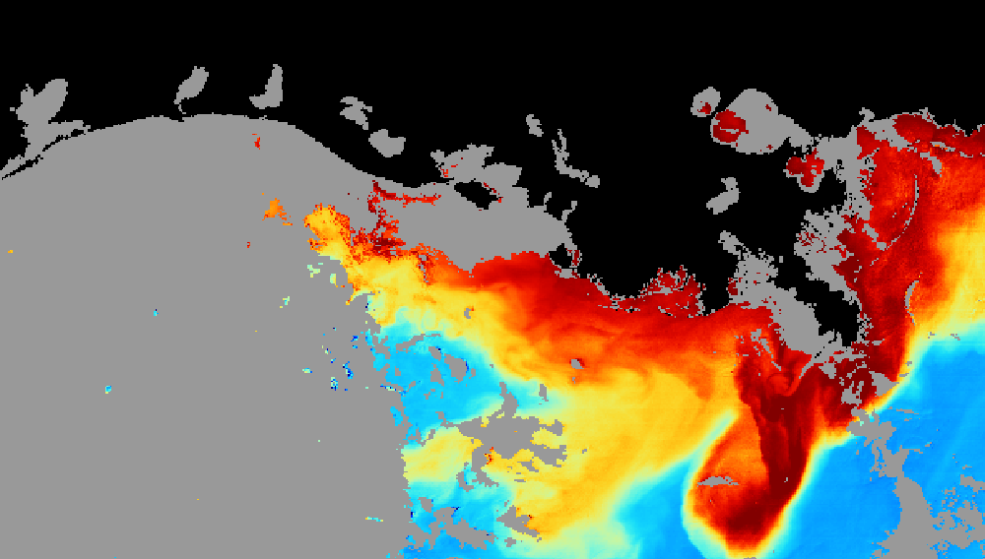
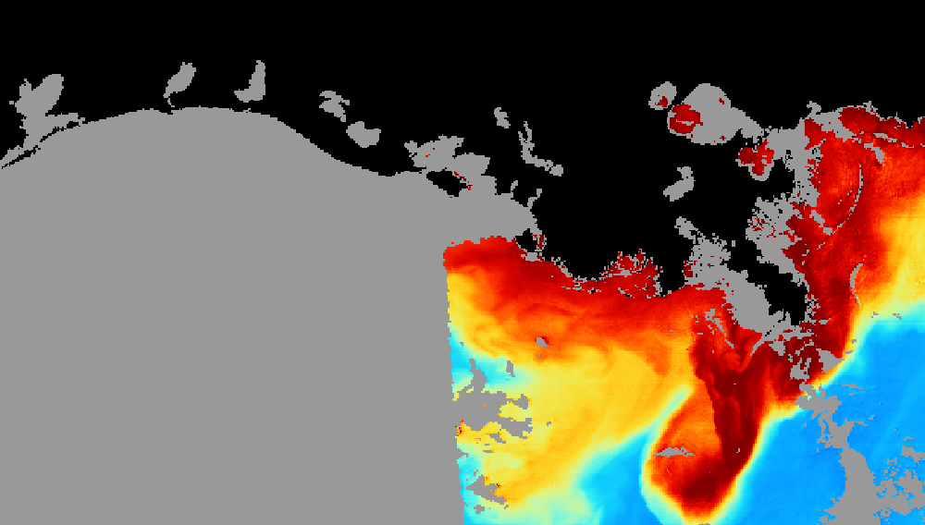
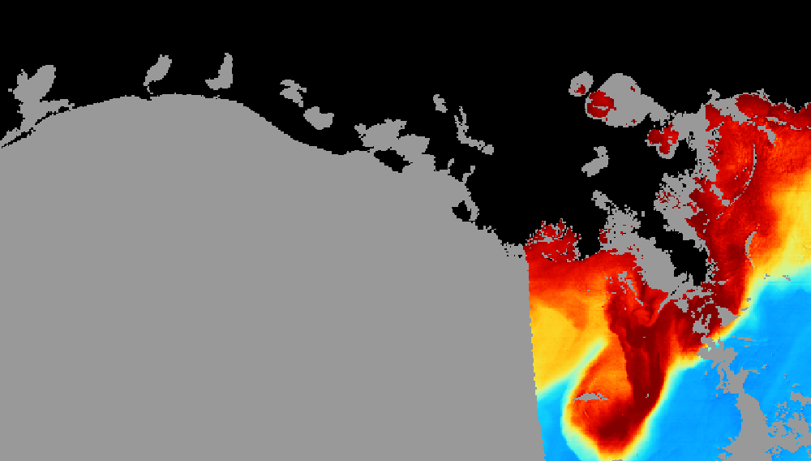
SeaDAS User Software: General Image Analysis Tools
Masking with Flagged Data
SeaDAS
General Image
Analysis Tools
Imagery
Masking
Mapping
Aggregation
Algorithms
Analysis
Statistics
True Color RGB
Chlorophyll (no glint masking)
User
Chlorophyll (HIGLINT)
Chlorophyll (HIGLINT, MODGLINT)

Slide 18
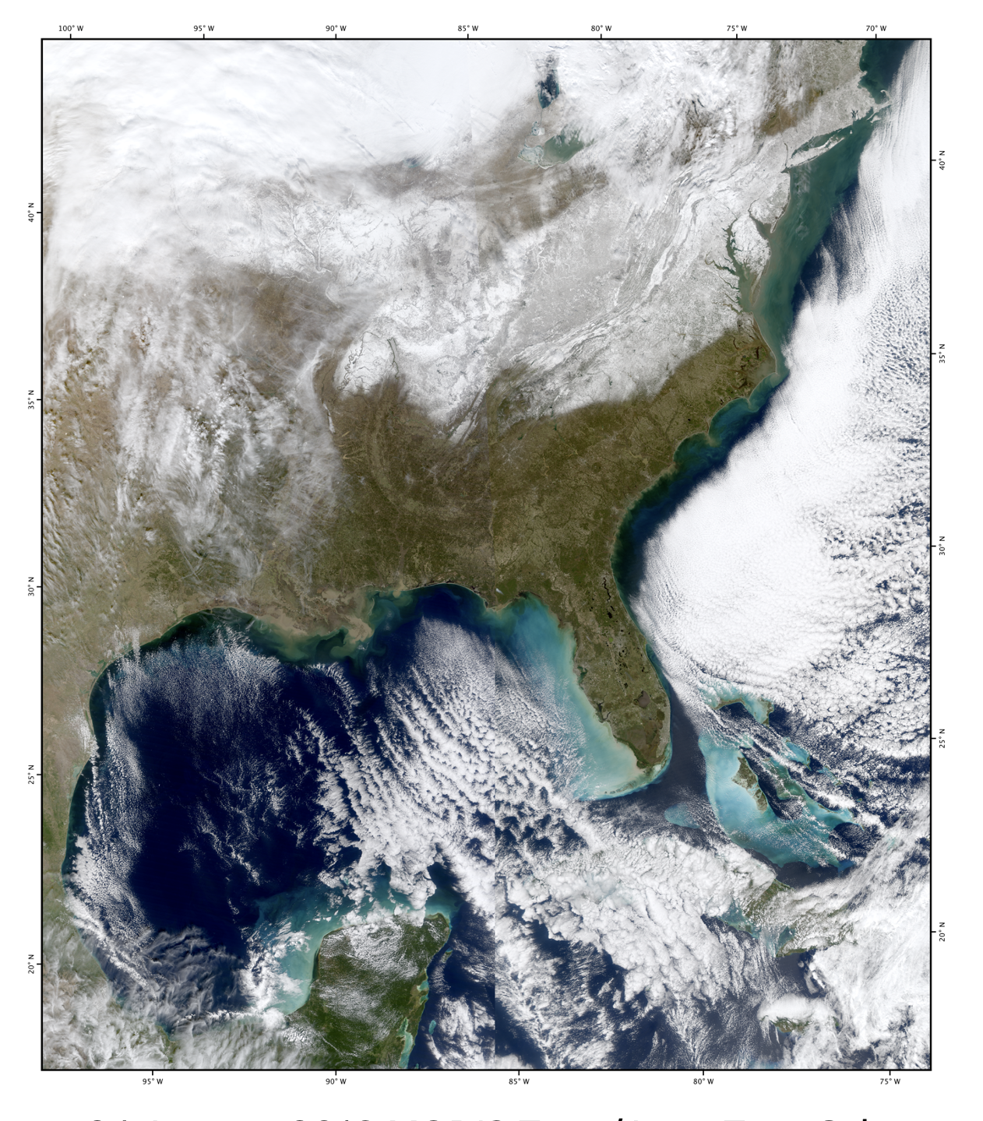
SeaDAS User Software: General Image Analysis Tools
Image Aggregation
SeaDAS
General Image
Analysis Tools
Imagery
Masking
Mapping
Aggregation
Algorithms
Analysis
Statistics
User
MODIS Terra
(two Level-2 files)
MODIS Aqua
(two Level-2 files)
MODIS Terra/Aqua
(four file aggregation) 24 January 2016

Slide 19
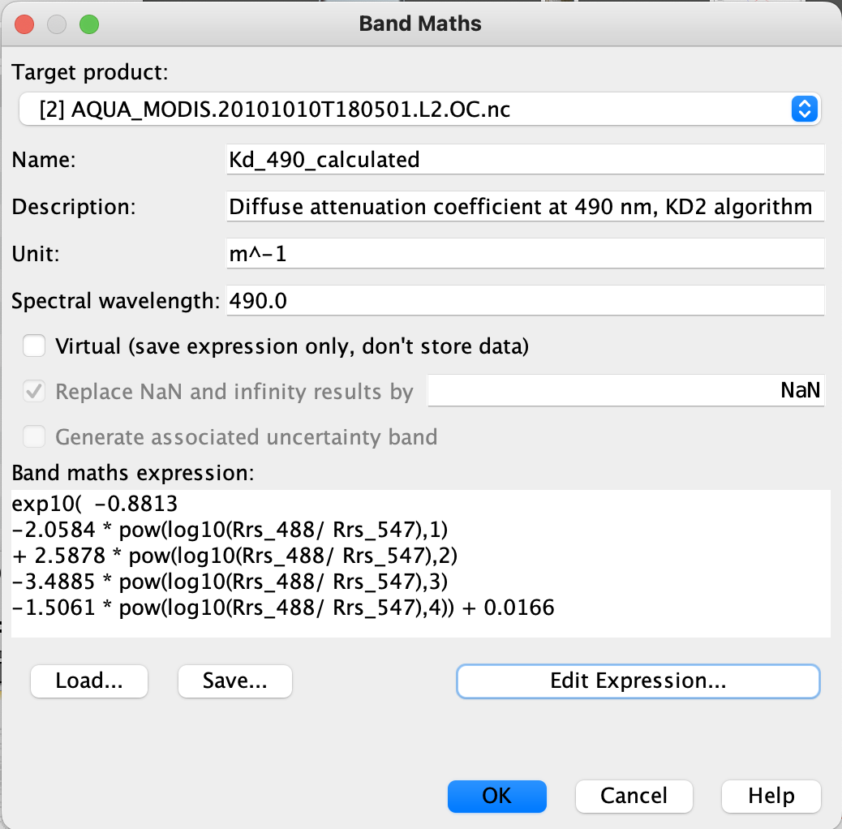
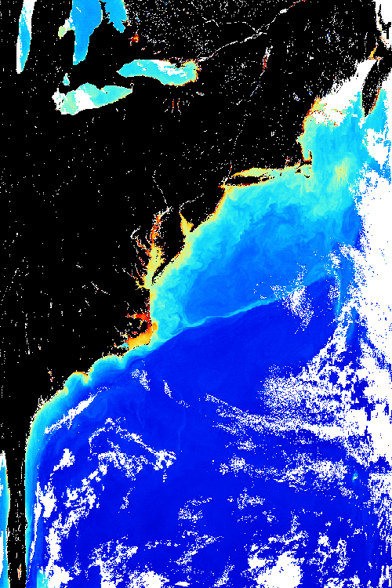
SeaDAS User Software: General Image Analysis Tools
Custom Math Expression Bands
SeaDAS
General Image
Analysis Tools
Imagery
Masking
Mapping
Aggregation
Algorithms
Analysis
Statistics
User

Slide 20
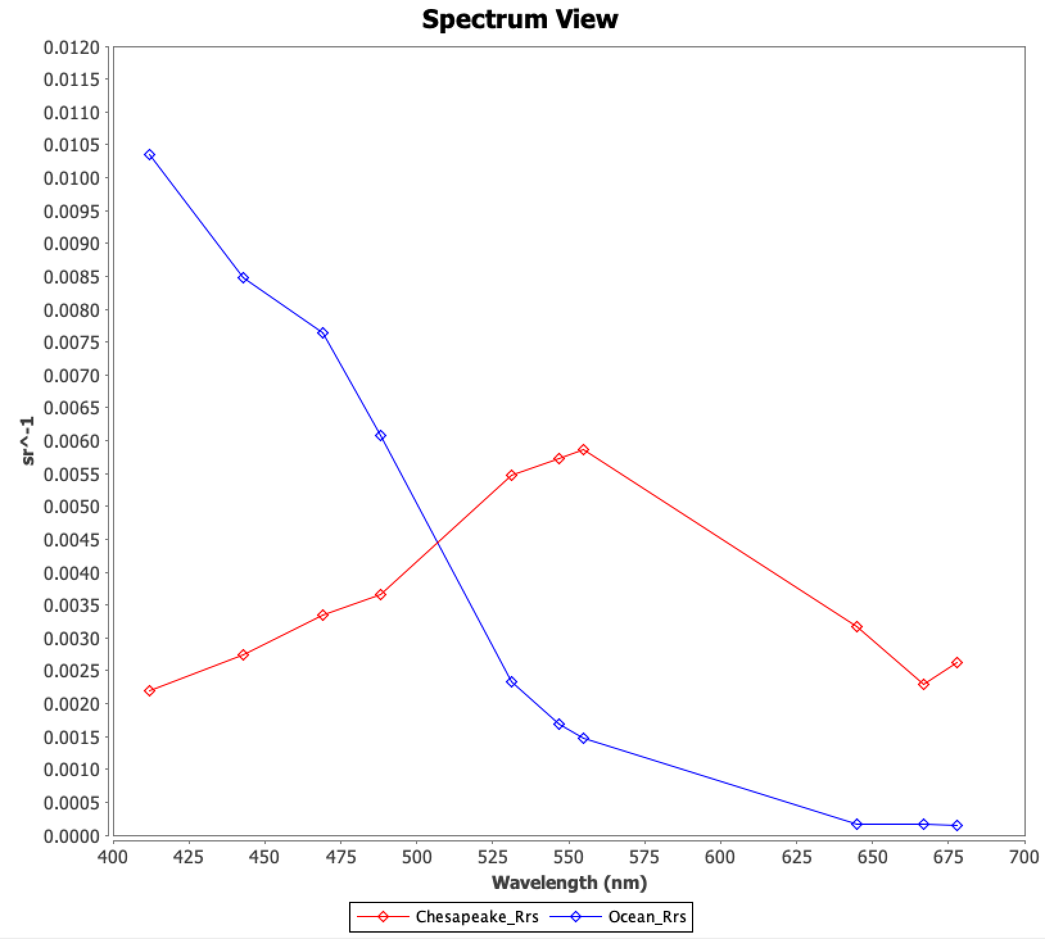
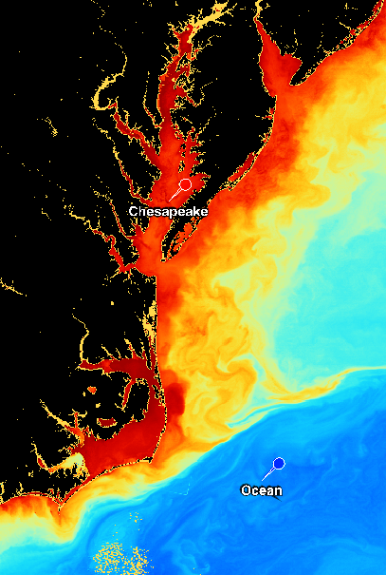
SeaDAS User Software: General Image Analysis Tools
Spectral Plots
SeaDAS
General Image
Analysis Tools
Imagery
Masking
Mapping
Aggregation
Algorithms
Analysis
Statistics
User

Slide 21
SeaDAS User Software: General Image Analysis Tools
Level-2 File
SeaDAS
General Image
Analysis Tools
Imagery
Masking
Mapping
Aggregation
Algorithms
Analysis
Statistics
User

Slide 22
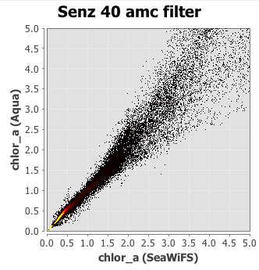
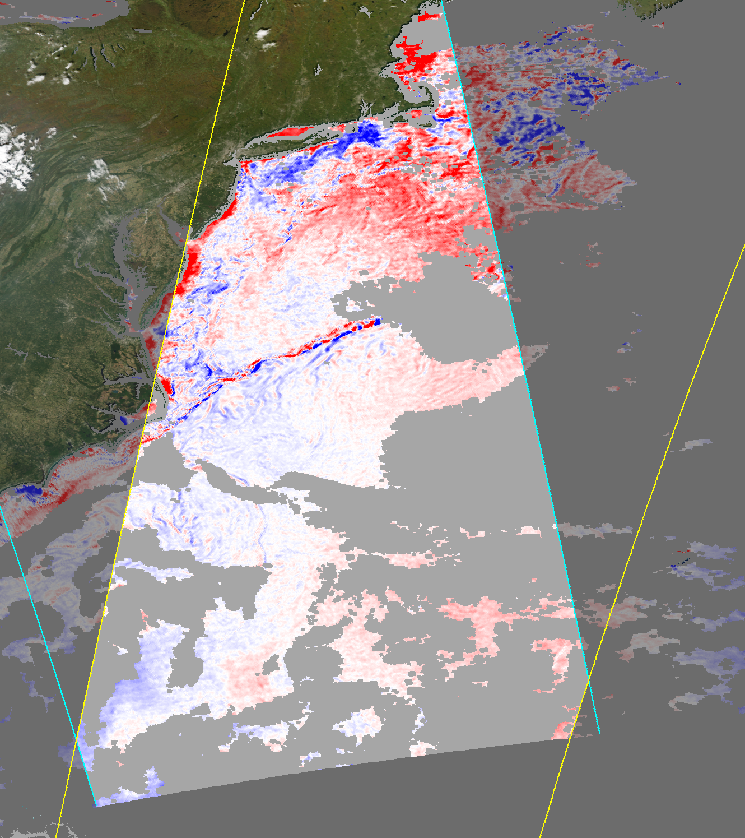
SeaDAS User Software: General Image Analysis Tools
Data Comparison
SeaDAS
General Image
Analysis Tools
Imagery
Masking
Mapping
Aggregation
Algorithms
Analysis
Statistics
MODIS Aqua chlor_a / SeaWiFS chlor_a
40 degree sensor zenith restriction
User
MODIS Aqua: Oct 10, 2010, 18:05 UTC
SeaWiFS: Oct 10, 2010, 19:11 UTC

Slide 23
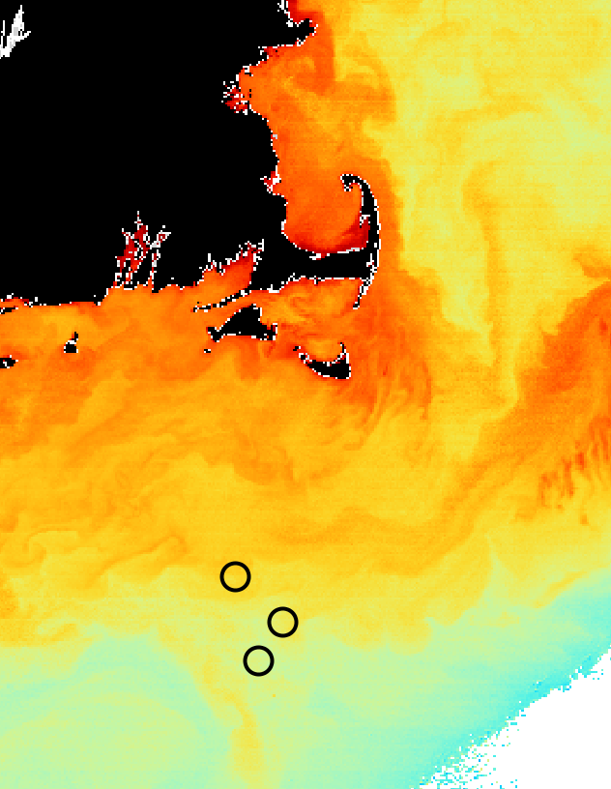
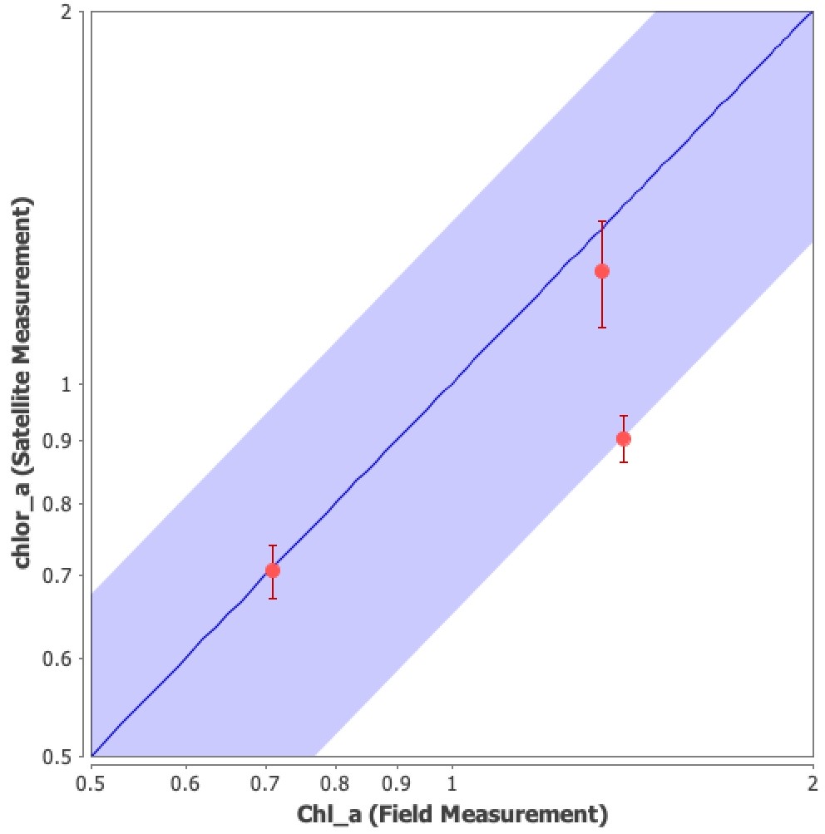
SeaDAS User Software: SeaBASS File Integration
MODIS / Field Measurement (SeaBASS) Comparison
SeaBASS Files
Comparison Plots
Location Overlays
Matchup Extraction
User

Slide 24
SeaDAS User Software
Science Processing Software
OCSSW and OB.DAAC

Slide 25
SeaDAS-OCSSW OB.DAAC: Data Downlink and Acquisition
Satellite
DN
DN
DN
Platform Geometry
(lat°, lon°)
(yaw, pitch, roll,)
L_{t}
Receiving Station
Data Provider
θ_{scan}
Level-0 Files*
Level-1A Files*
Level-1B Files*
Non-Absorbing
Gases
Gases
Clouds
Aerosols
θ_{solz}
OB.DAAC
θ_{satz}
ODPS
Ocean
Data
Processing
System
L_{w}
Foam
(lat°, lon°)
* Mission dependent

Slide 26
SeaDAS-OCSSW OB.DAAC: Software Data Flow and Tools
Satellite
SeaDAS
General Image
Analysis Tools
Imagery
Masking
Mapping
Aggregation
Algorithms
Analysis
Statistics
SeaDAS Science
Processing Tools
Level-0 Files*
Level-1A Files*
Level-1B Files*
Receiving Station
Data Provider
Geo Files*
Geo Files*
Level-1B Files*
Level-0 Files*
Level-1A Files*
Level-1B Files*
Level-2 Files*
Level-2 Files*
ESA SNAP Processing Tools
Level-3 Binned Files
Level-3 Binned Files
Level-3 Mapped Files
Level-3 Mapped Files
OB.DAAC
ODPS
Ancillary Files
User
Ancillary Files
Ancillary Sources
SeaBASS Files
* Mission dependent

Slide 27
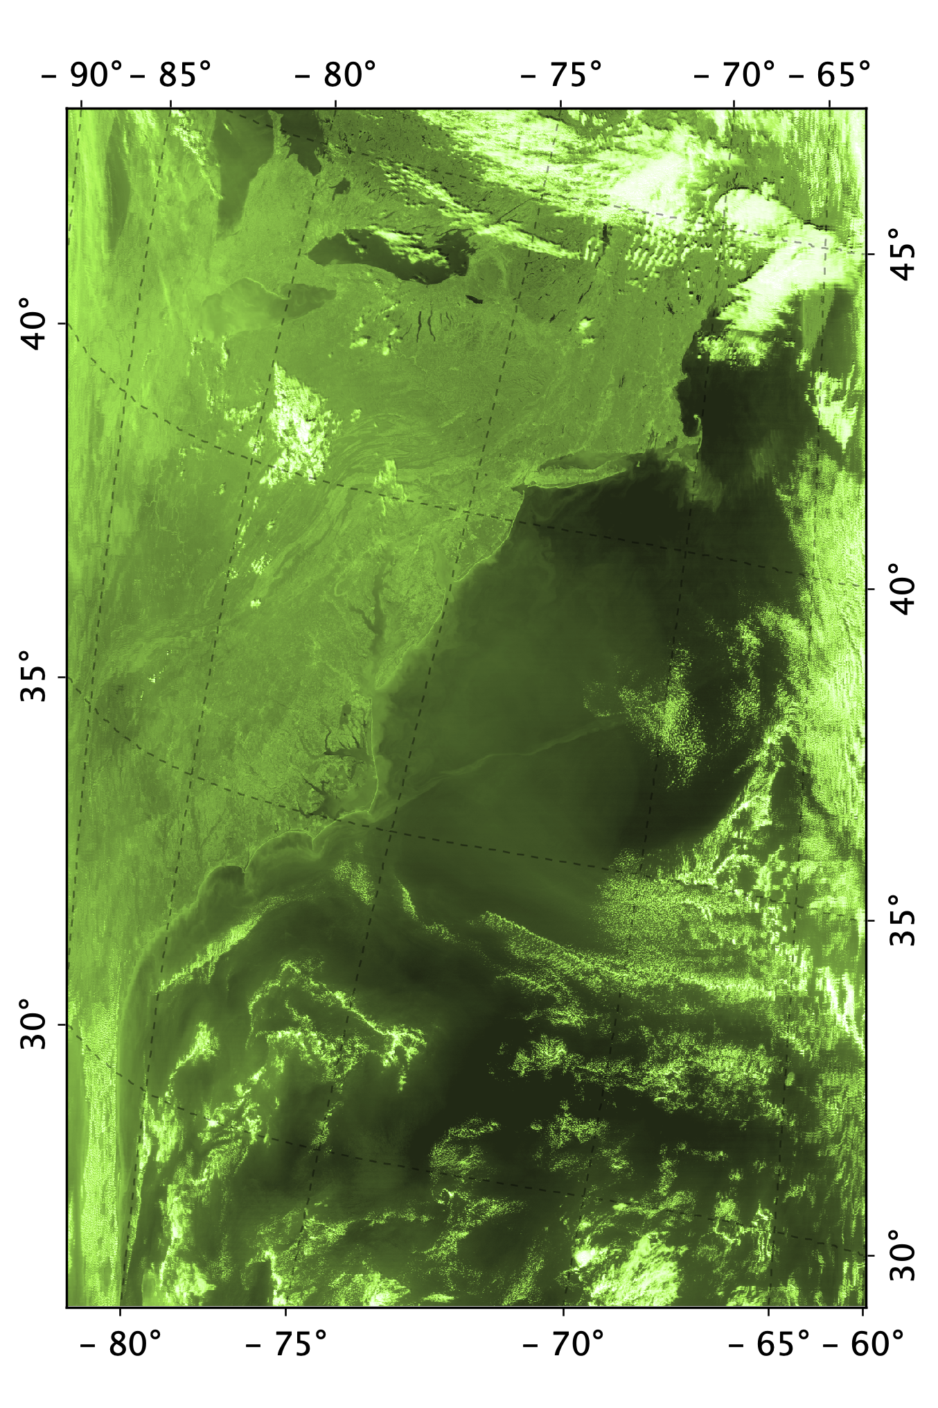
SeaDAS-OCSSW OB.DAAC: Level-2 Files
Level-2 File: Key Points
Native resolution
Each pixel gridded same as corresponding L1A and L1B files
Each pixel contains time and location
Adjacent pixels may or may not be geographically adjacent
MODIS has some 500m and 250m bands*
Contains derived geophysical variables
OC, IOP, SST Suites
Contains level-2 flags
Instrument Calibration has been applied
Atmospheric correction has been applied
Vicarious Calibration has been applied
Ancillary data has been applied
File format is mission independent
User Options
Many additional geophysical, ancillary and geometric products
Atmospheric correction and processing options
Users can set many of the flag thresholds
MODIS has some 500m and 250m bands
Level-2 File

Slide 28
SeaDAS-OCSSW OB.DAAC: Level-2 Files
Level-2 Files
OB.DAAC Level-2 Data:
Geophysical Products: OC Suite
Geophysical Products
OC
IOP
SST
Flags
Native Pixels (Location, Time)
Atmospheric Correction
Vicarious Calibration
Terrain Correction
Rrs Remote Sensing Reflectance
chlor_a Chlorophyll Concentration
Kd_490 Diffuse Attenuation Coefficient
pic Particulate Inorganic Carbon
poc Particulate Organic Carbon
aot Aerosol Optical Thickness
par Photosynthetically Available Radiation
ipar Instantaneous Photosynthetically Available Radiation
nflh Normalized Fluorescence Line Height
angstrom Aerosol Angstrom Exponent
Product (Rrs) for each applicable visible band of the satellite sensor
“par” is currently estimated as above the surface, new algorithm will be developed for below the surface.
Algorithms available at: https://oceancolor.gsfc.nasa.gov/resources/atbd
OB.DAAC
ODPS

Slide 29
SeaDAS-OCSSW OB.DAAC: Level-2 Files
Level-2 Files
OB.DAAC Level-2 Data:
Geophysical Products: IOP Suite
Geophysical Products
OC
IOP
SST
Flags
Native Pixels (Location, Time)
Atmospheric Correction
Vicarious Calibration
Terrain Correction
a Total Absorption
bb Total Backscattering
aph Absorption due to Phytoplankton
aph_unc Uncertainty (aph)
adg Absorption due to gelbstoff and detrital matter
adg_s Spectral Parameter (adg)
adg_unc Uncertainty (adg)
bbp Particulate Backscattering
bbp_s Spectral Parameter (bbp)
bbp_unc Uncertainty (bbp)
rrsdiff Fractional Mean Rrs Difference
OB.DAAC
Products (a, bb) for each applicable visible band of the satellite sensor
ODPS

Slide 30
SeaDAS-OCSSW OB.DAAC: Level-2 Files
Level-2 Files
OB.DAAC Level-2 Data:
Geophysical Products: SST Suite
Geophysical Products
OC
IOP
SST
Flags
Native Pixels (Location, Time)
Atmospheric Correction
Vicarious Calibration
Terrain Correction
sst Sea Surface Temperature
sstref Sea Surface Temperature Reference
qual_sst Quality Levels (sst)
bias_sst Bias (sst)
stdv_sst Standard Deviation (sst)
Missions: Level-2 SST Data in OB.DAAC
MODIS Aqua
MODIS Terra
VIIRS Suomi NPP
VIIRS NOAA20
VIIRS NOAA21*
OB.DAAC
ODPS
* In production, will be available soon
SST (day and night: 11 and 12 microns)
MODIS: SST4 (nighttime: 3.9, 11, 12 microns)
VIIRS: SST3 (nighttime: 3.7, 11, 12 microns)

Slide 31
SeaDAS-OCSSW OB.DAAC: Level-2 Files
Level-2 Files
OB.DAAC Level-2 Data:
Flags
Geophysical Products
Flags
Native Pixels (Location, Time)
Atmospheric Correction
Vicarious Calibration
Terrain Correction
CLDICE Cloud/Ice determined
COCCOLITH Coccolithophores detected
FILTER Insufficient data for smoothing filter
HIGLINT High glint determined
HILT High (or saturating) TOA radiance
HIPOL High degree of polarization determined
LOWLW Low Lw @ 555nm (possible cloud shadow)
MODGLINT Moderate glint determined
SEAICE Sea ice determined
STRAYLIGHT Straylight determined
TURBIDW Turbid water determined
COASTZ Shallow water (<30m)
HISATZEN Large satellite zenith angle
HISOLZEN High solar zenith angle
LAND Land
OB.DAAC
ODPS

Slide 32
SeaDAS-OCSSW OB.DAAC: Level-2 Files
Level-2 Files
OB.DAAC Level-2 Data: Native Pixels
Geophysical Products
Flags
Native Pixels
Atmospheric Correction
Vicarious Calibration
Terrain Correction
Same pixel gridding as L1A and L1B files
Each pixel contains time and location
No assumed mapping projection
Adjacent pixels are based on instrument data and not scene location
Adjacent pixel may not be geographically adjacent
Bow-tie effect
OB.DAAC
ODPS

Slide 33
SeaDAS-OCSSW OB.DAAC: Level-2 Files
Level-2 Files
Atmospheric Correction
Geophysical Products
Flags
Native Pixels (Location, Time)
Atmospheric Correction
Vicarious Calibration
Terrain Correction
L_{t} = (L_{r} + L_{a} + t_{d}L_{f} + TL_{g} + t_{d}L_{w} ] t_{g} f_{p}
sat-measured
sat-measured
(NIR)
sat-derived
Data Used in Atmospheric Correction Algorithm
Level-2 Files
wind speed
surface pressure
ozone and NO2 concentrations
water vapor concentration
relative humidity
sea surface temperature
on-board near-infrared measurements
OB.DAAC
ODPS
Ancillary Files
Ancillary Data Sources
MERRA-2 (GMAO)
CMC-L4_GHRSST-SSTfnd-CMC0.2deg
Ancillary Files
Ancillary Sources

Slide 34
SeaDAS-OCSSW OB.DAAC: Level-2 Files
Level-2 Files
Vicarious Calibration Methodology
Geophysical Products
Flags
Native Pixels (Location, Time)
Atmospheric Correction
Vicarious Calibration
Terrain Correction
Apply inverted atmospheric correction
Determine vicarious gain correction coefficient
Average vicarious gain correction coefficient
Apply to satellite measurement
L_{t} (vicarious derived) = f ( L_{w} (vicarious measured) )
L_{t} (vicarious derived)
g_{i} =
L_{t} (satellite measured)
n
∑
g =
1
g_{i}
n
i=1
OB.DAAC
ODPS
gL_{t} = (L_{r} + L_{a} + t_{d}L_{f} + TL_{g} + t_{d}L_{w} ] . t_{g} . f_{p}
sat-measured
sat-measured
sat-derived

Slide 35
SeaDAS-OCSSW OB.DAAC: Level-2 Files
Level-2 Files
Terrain Correction
Geophysical Products
Flags
Native Pixels (Location, Time)
Atmospheric Correction
Vicarious Calibration
Terrain Correction
Elevated lakes
Elevated land
Corrects locations
Corrects sun angle
L_{t}
(lat°, lon°)
(lat°, lon°)
θ_{s}
θ_{s}
OB.DAAC
ODPS
Sea Level

Slide 36
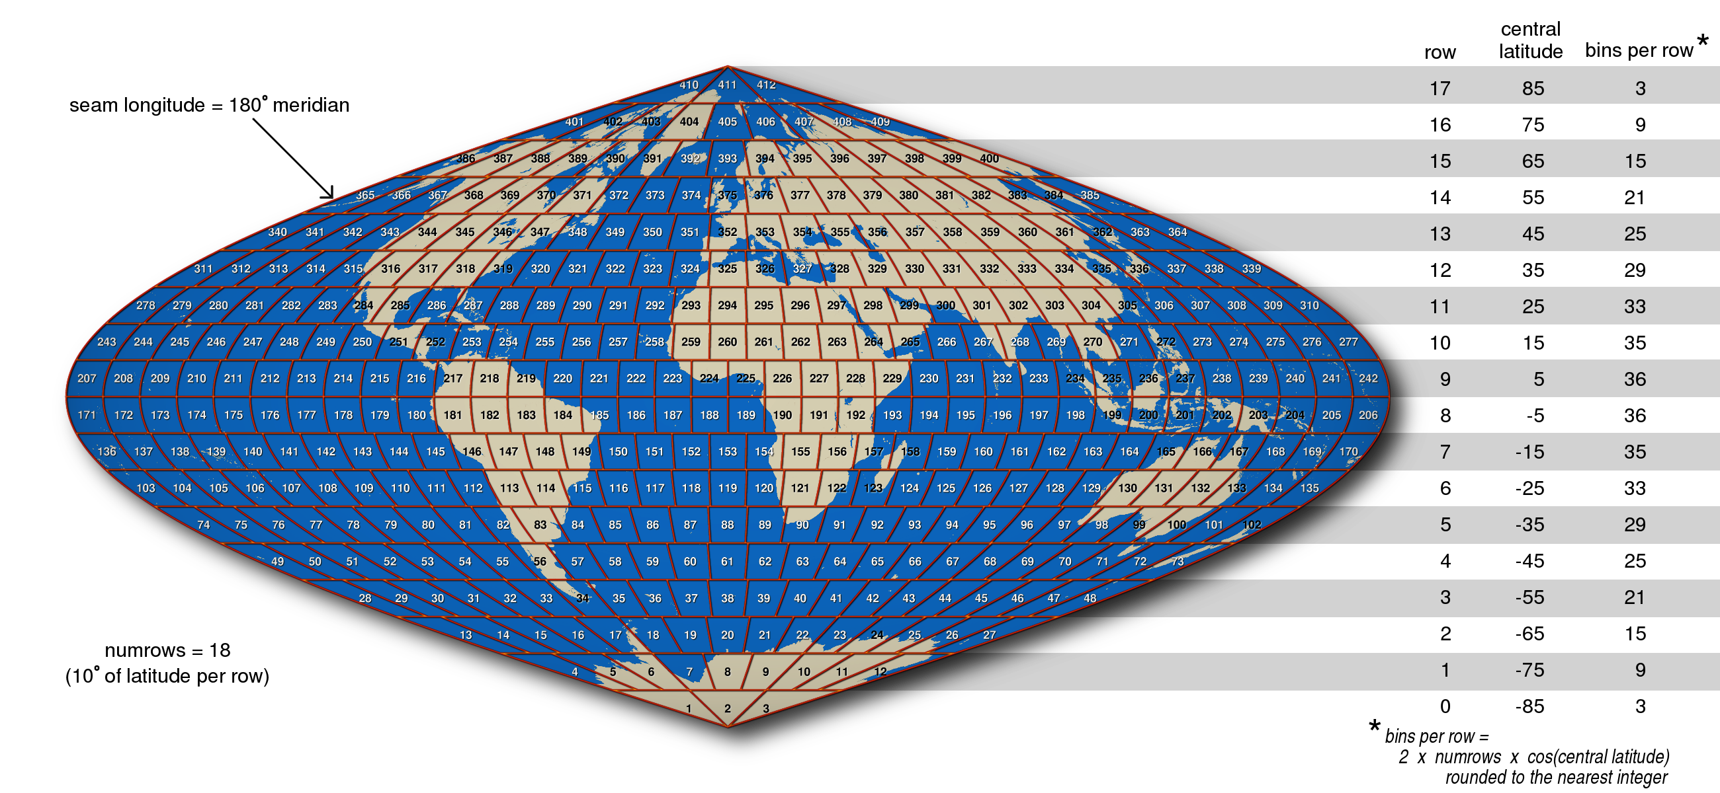
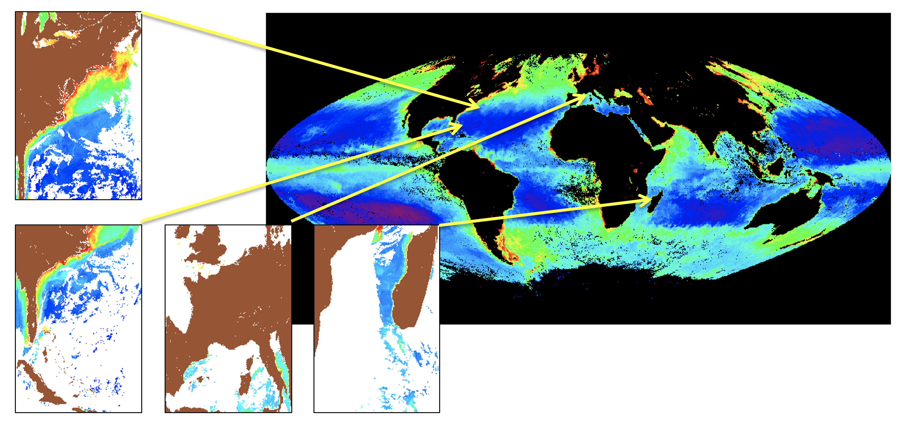
SeaDAS-OCSSW OB.DAAC: Level-3 Binned Files
Level-3 Binned Data: Key Points
Accumulated data from L2 products
Equal surface area bins
Projection: Integerized Sinusoidal
Applies level-2 flags (suite specific)
Each “valid” level-2 pixel goes in a single level-3 bin
Bin Contents
Product Value (Mean)
Count
Standard Deviation, Sum, Sum Squared, Weight
Bin Resolutions (OB.DAAC)
4.64 km (Lat Span=1/24°, Rows=4320)
Time Resolutions (OB.DAAC)
Day, 8 Day, Month, Seasonal, Annual, Mission
Global Files (OB.DAAC)
Handles “Bow-Tie” Pixels
User Options
Many Bin Resolutions
Any Time Resolution

Slide 37
SeaDAS-OCSSW OB.DAAC : Level-3 Binned Files
Level-3 Bin Spatial Resolutions
Angular Distance | Number Rows | Average Bin Height* | Short Name**
1° | 180 | 111.32 km | 1D
1/2° | 360 | 55.66 km | HD
1/3° | 535 | 37.45 km | 36
1/4° | 720 | 27.83 km | QD
1/6° | 1080 | 18.55 km | 18
1/12° | 2160 | 9.28 km | 9
1/24° | 4320 | 4.64 km | 4
1/48° | 8640 | 2.32 km | 2
1/96° | 17280 | 1.16 km | 1
1/192° | 34560 | 580 m | H
1/384° | 69120 | 290 m | Q
1/1920° | 345600 | 58 m | HH
Angular Span (Latitude) Rows Bin Resolution Short Name
* Bin height displayed is average and approximate based on a spherical Earth having a radius of 6378.145 kilometers
** Short name is subject to change in the future

Slide 38
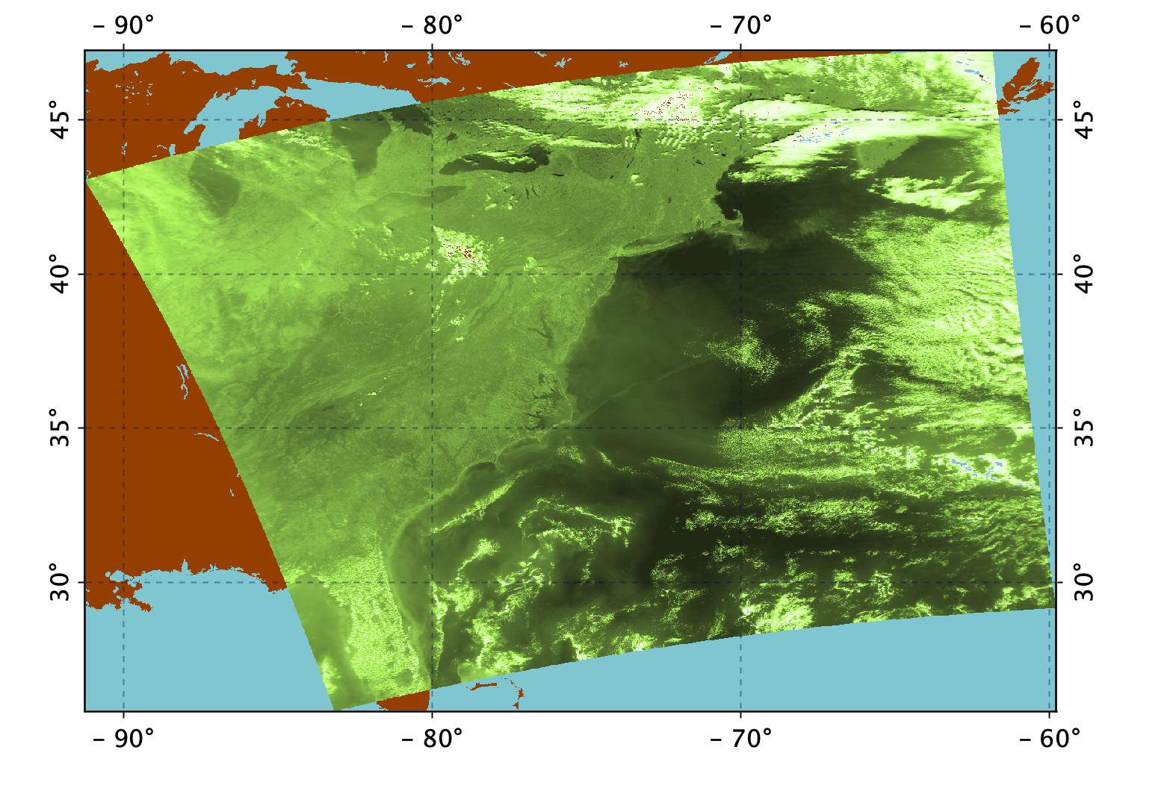
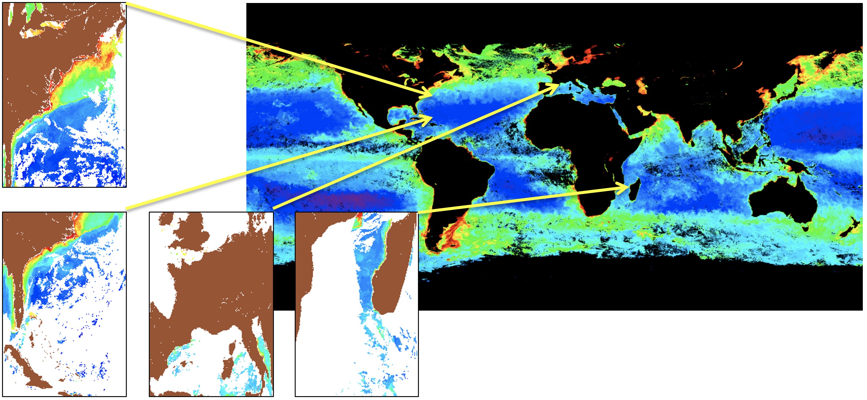
SeaDAS-OCSSW OB.DAAC : Level-3 Mapped Files
Level-3 Mapped Data: Key Points
Not equal surface area pixels (OB.DAAC)
Projection: SMI (Plate Carrée)
Interpolation: Nearest Neighbor (OB.DAAC)
Each mapped pixel populated by up to one bin
A single bin can go into multiple mapped pixels
Pixel Contents
Product Value
Spatial Resolutions (OB.DAAC)
4.64 km
9.28 km
Time Resolutions (OB.DAAC)
Day, 8 Day, Month, Seasonal, Annual, Mission
Global Files (OB.DAAC)
Level-3 Mapped File
User Options
Any Spatial Resolution
Many Mappings (including raw bin dump)

Slide 39
SeaDAS-OCSSW: OB.DAAC vs User Generated Files
OB.DAAC
Level-2
Limited geophysical products available
No ancillary and geometric products
Default flag thresholds
Only 1 resolution
Level-3 Binned
Only 4km resolution available
Limited time resolutions available
Already processed and available
Level-3 Mapped
4km and 9km resolution available
SMI Mapping
User Generated
Level-2
Many geophysical products available
Many ancillary and geometric products
Flag thresholds
Resolution choices (MODIS only)
Level-3 Binned
Many resolutions available
Any time resolution available
Could involve substantial runtime and resources
Level-3 Mapped
Any spatial resolution available
Many mappings, raw bin dump

Slide 40
SeaDAS-OCSSW OB.DAAC: Software Data Flow and Tools
Satellite
SeaDAS
General Image
Analysis Tools
Imagery
Masking
Mapping
Aggregation
Algorithms
Analysis
Statistics
SeaDAS Science
Processing Tools
Level-0 Files*
Level-1A Files*
Level-1B Files*
Receiving Station
Data Provider
Geo Files*
Geo Files*
Level-1B Files*
Level-0 Files*
Level-1A Files*
Level-1B Files*
Level-2 Files*
Level-2 Files*
ESA SNAP Processing Tools
Level-3 Binned Files
Level-3 Binned Files
Level-3 Mapped Files
Level-3 Mapped Files
OB.DAAC
ODPS
Ancillary Files
User
Ancillary Files
Ancillary Sources
SeaBASS Files
* Mission dependent

Slide 41
SeaDAS Workflow: 1
Source file: A2023011185000.L1A_LAC

Slide 42
SeaDAS Demo: Workflow 1
Level-1A File
modis_L1B
Level-1B File*
l2gen
Level-2 File
l2bin
modis_GEO
Geo File
Ancillary File
Level-3 Binned File
l3mapgen
Level-3 Mapped File
modis_L1B -o AQUA_MODIS.20230111T185000.L1B.sub.hdf -k AQUA_MODIS_HKM.20230111T185000.L1B.sub.hdf -q AQUA_MODIS_QKM.20230111T185000.L1B.sub.hdf AQUA_MODIS.20230111T185000.L1A.sub AQUA_MODIS.20230111T185000.GEO.sub.hdf

Slide 43
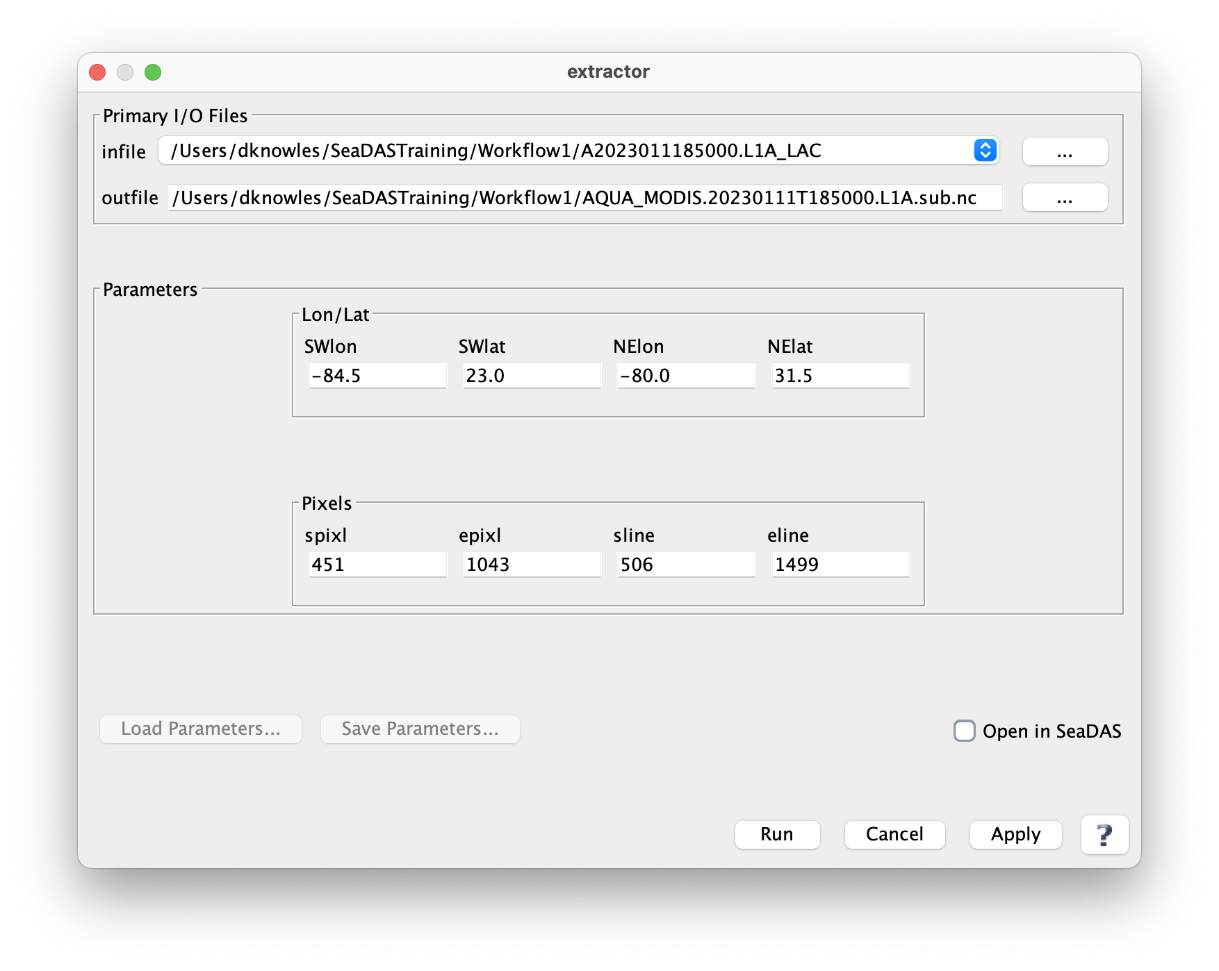
Workflow 1: Create MODIS L1A Extract File (optional)

Slide 44
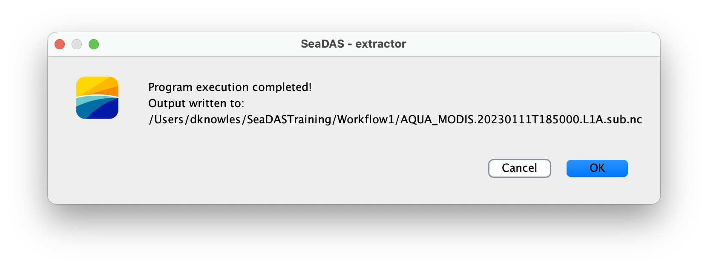
Workflow 1: Create MODIS L1A Extract File (Results message)

Slide 45
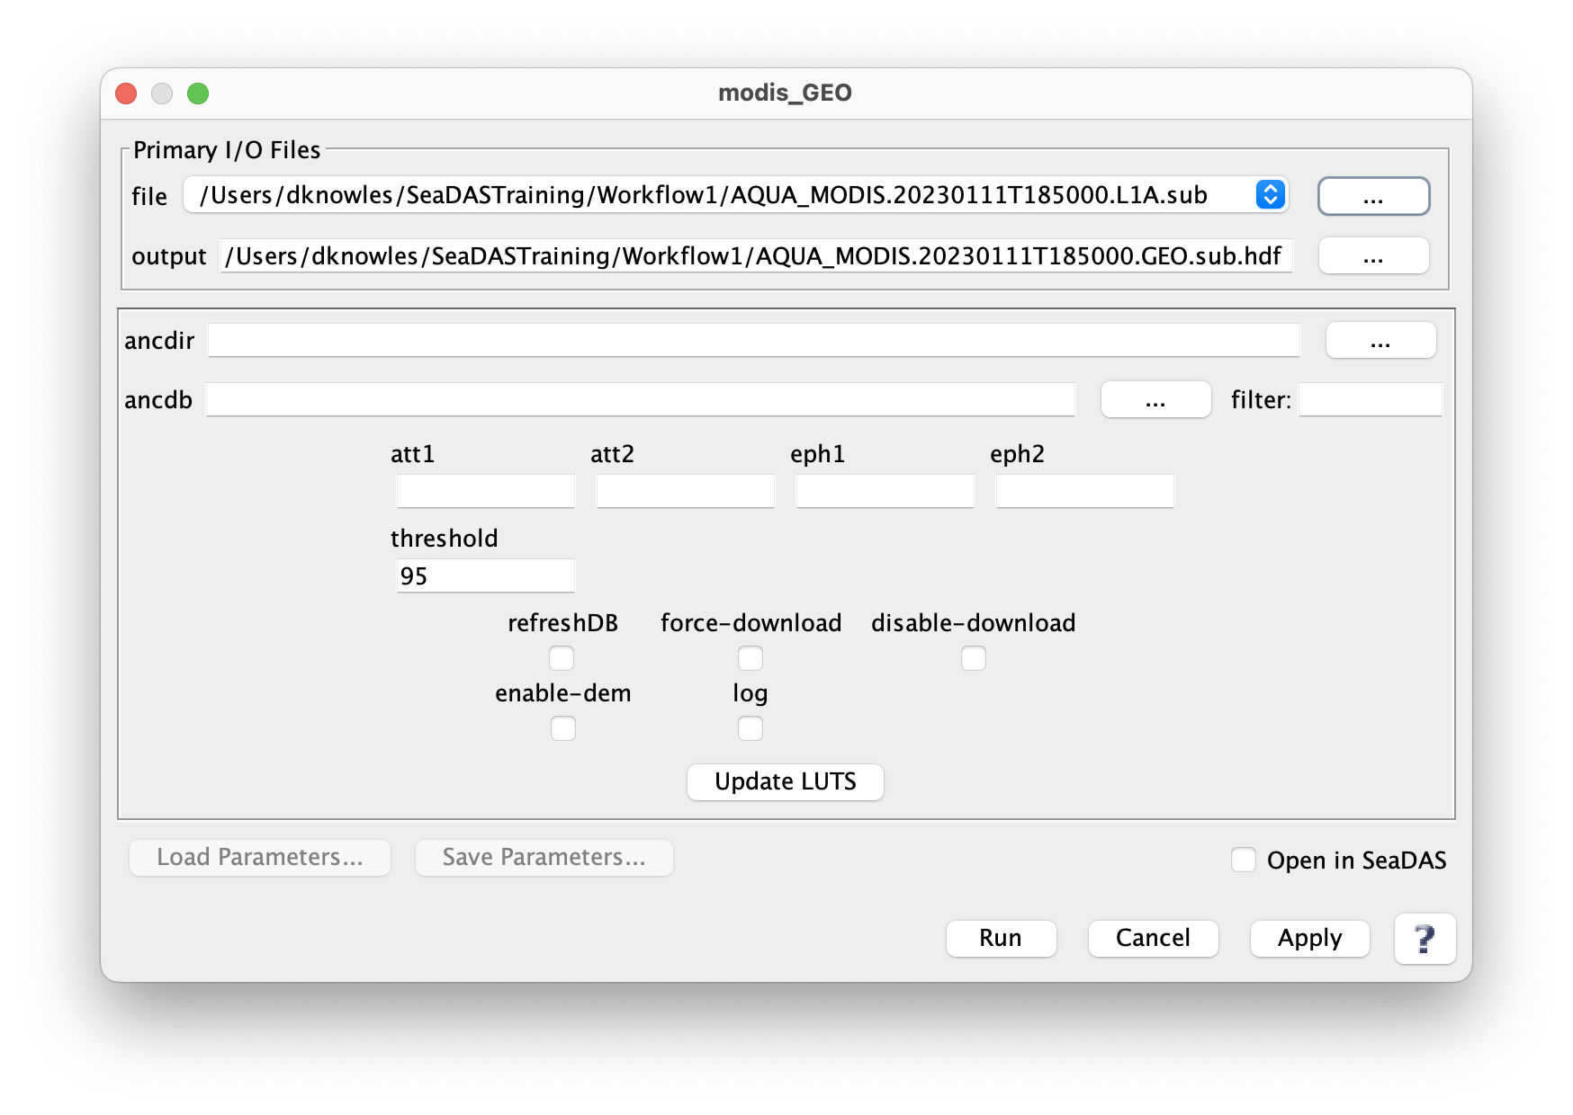
Workflow 1: Create MODIS GEO File

Slide 46
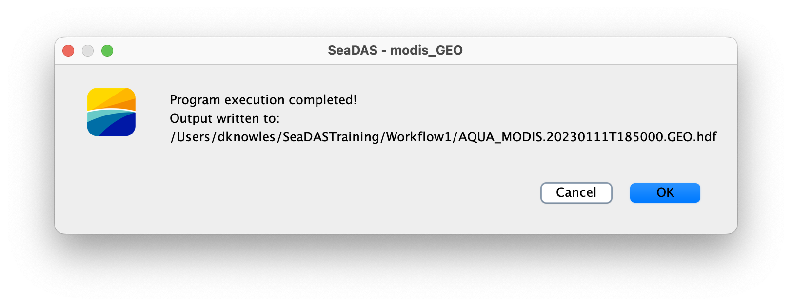
Workflow 1: Create MODIS GEO File (Results message)

Slide 47
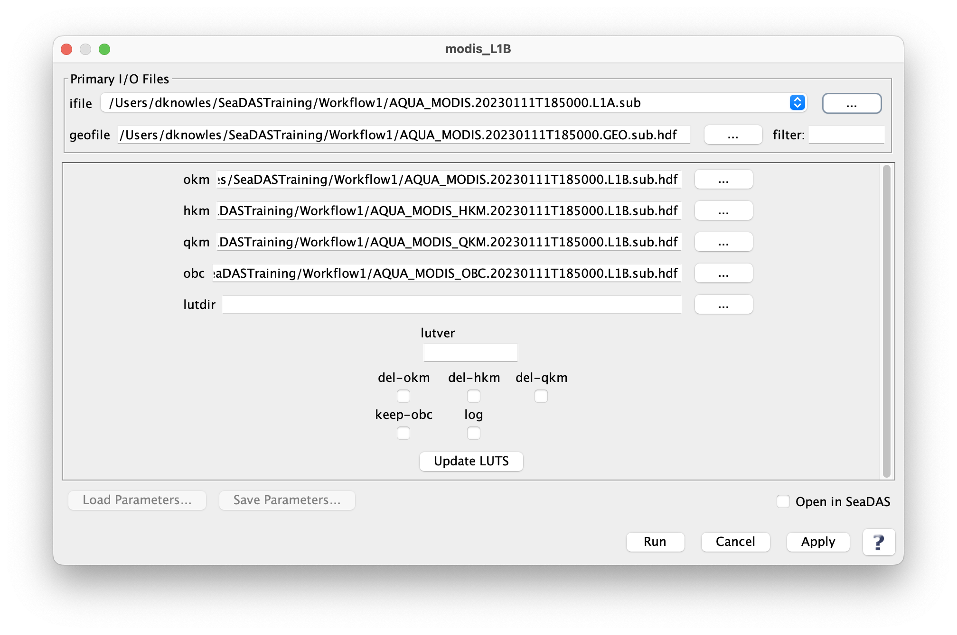
Workflow 1: Create MODIS L1B File (Select ”ifile” and click “Run”)

Slide 48
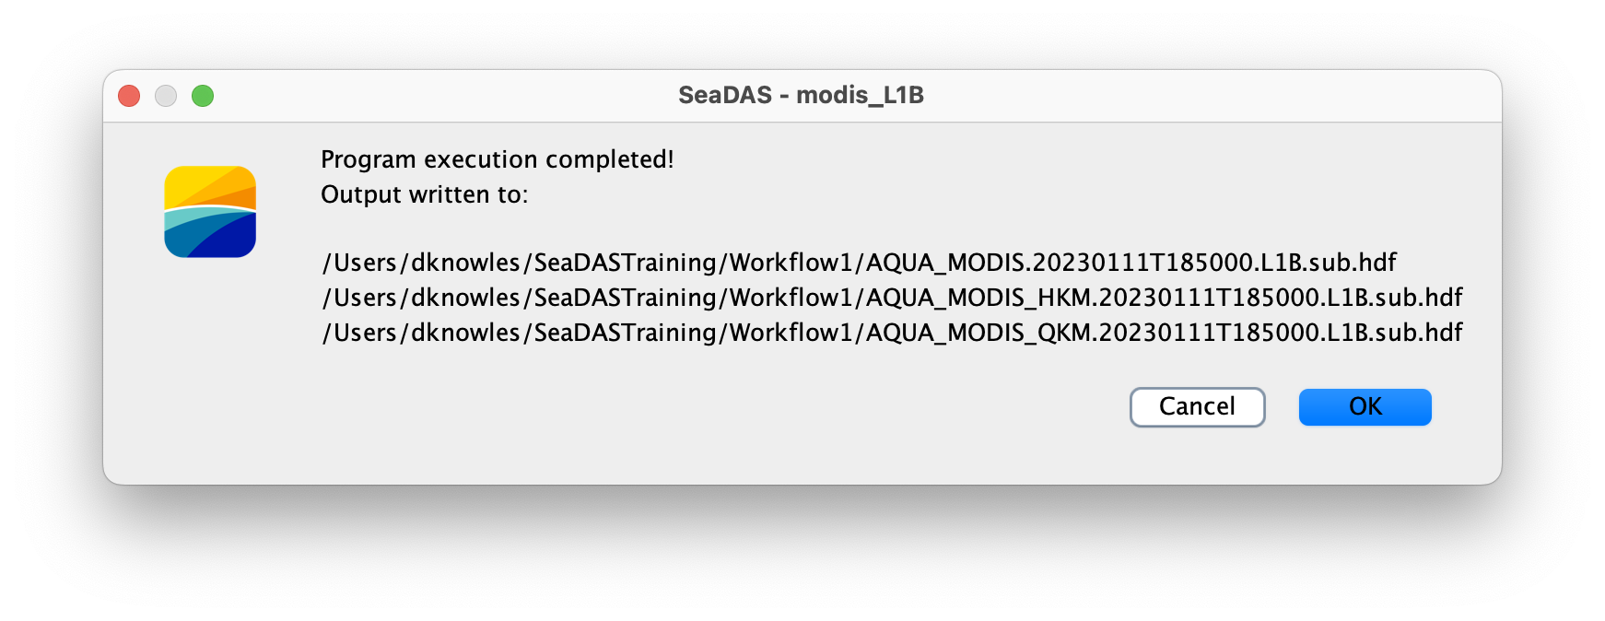
Workflow 1: Create MODIS L1B File (Results message)

Slide 49
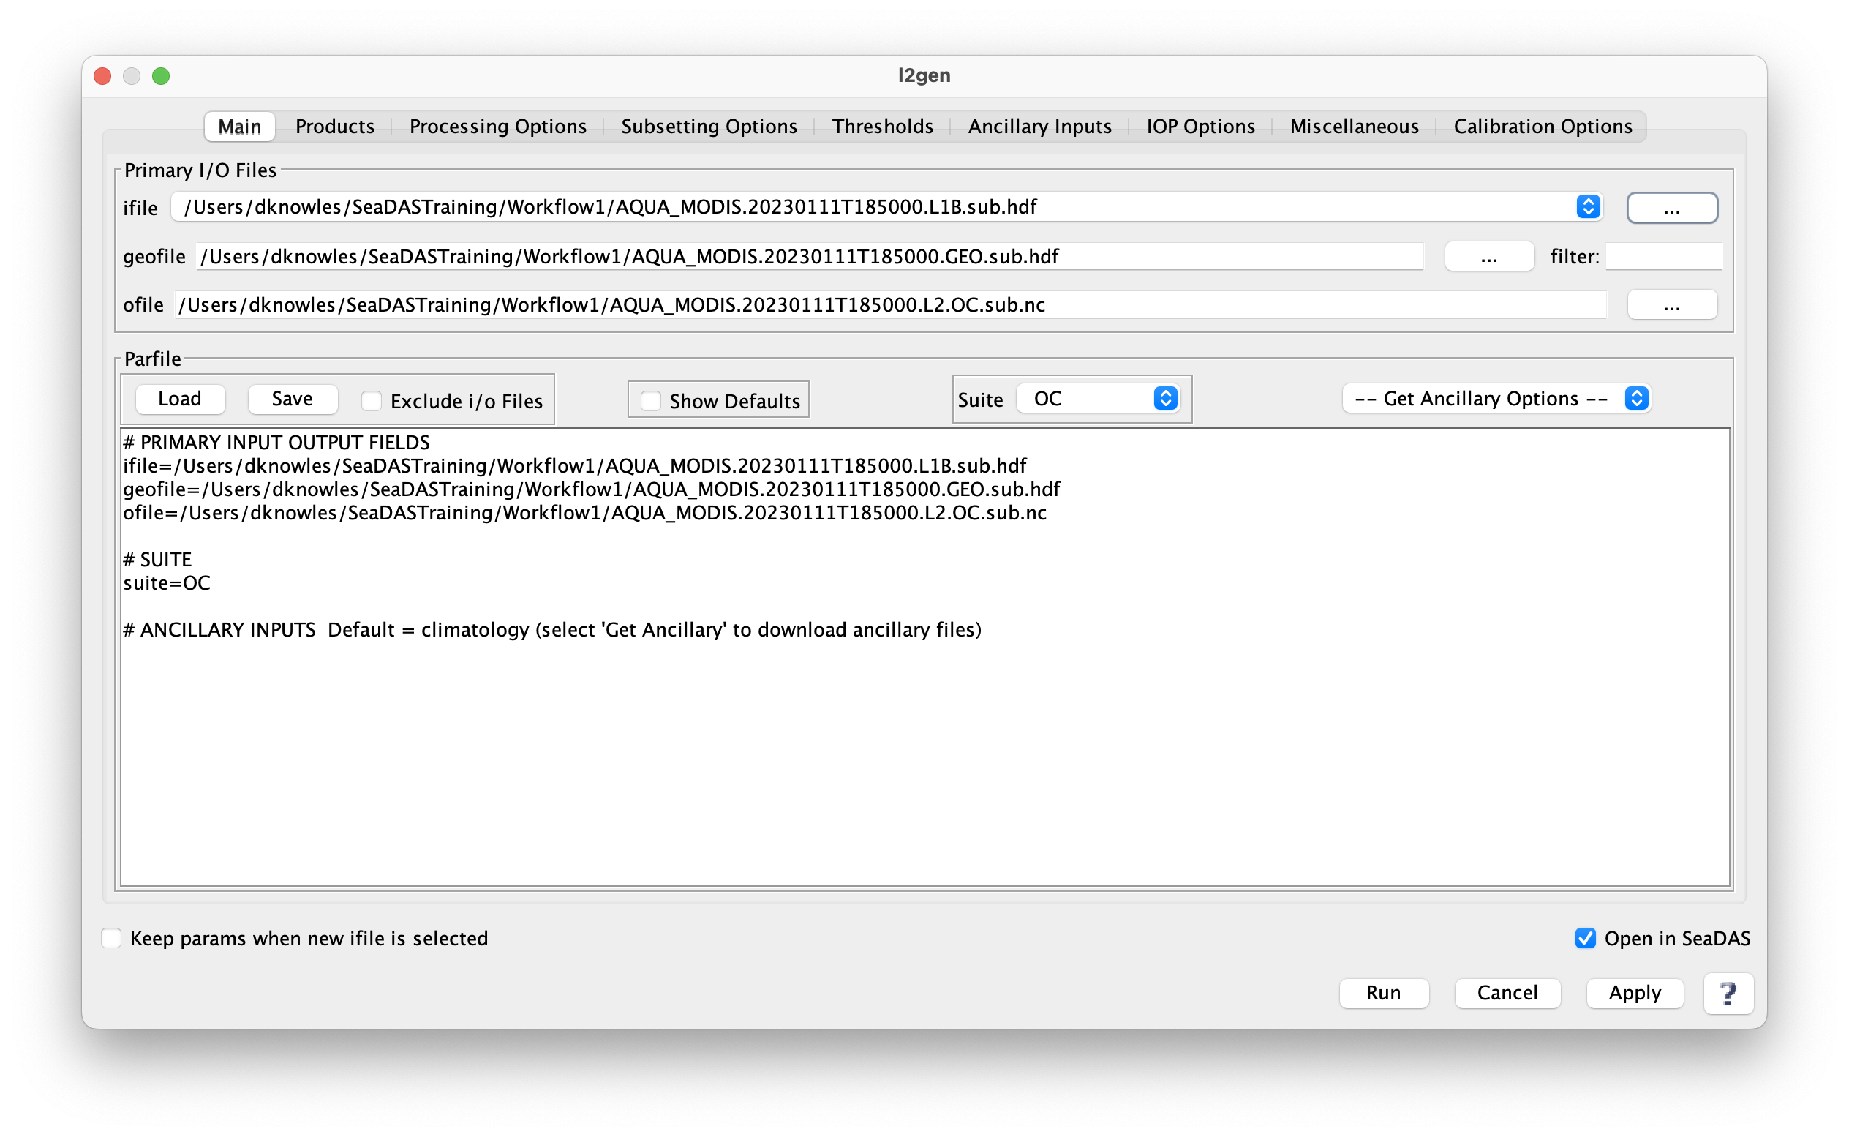
Workflow 1: Create MODIS L2 File (Select “ifile”)

Slide 50
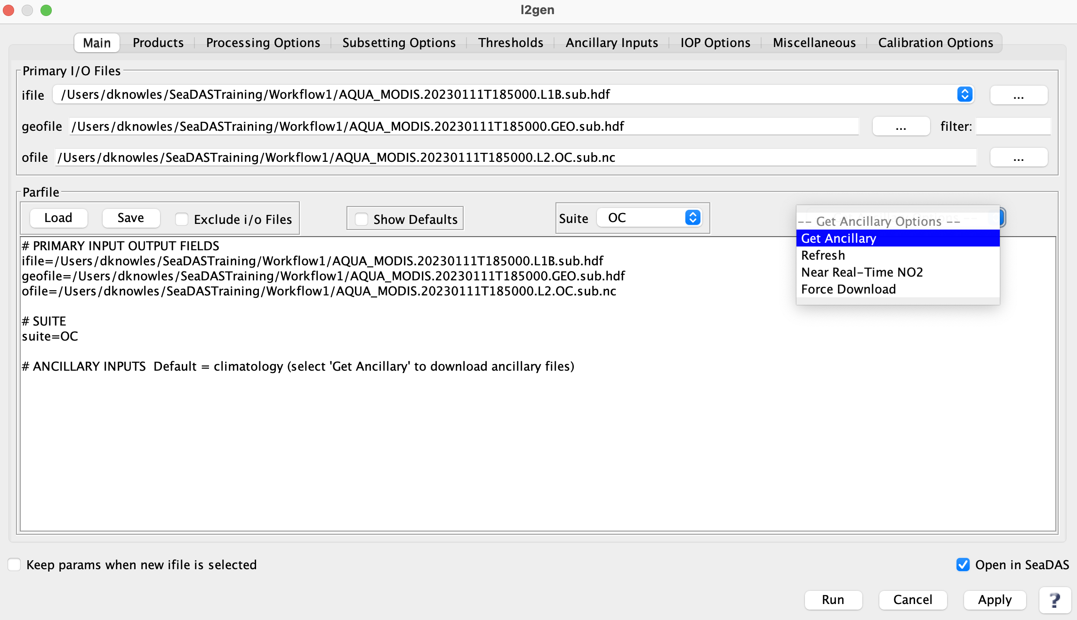
Workflow 1: Create MODIS L2 File (Select “Get Ancillary”)

Slide 51
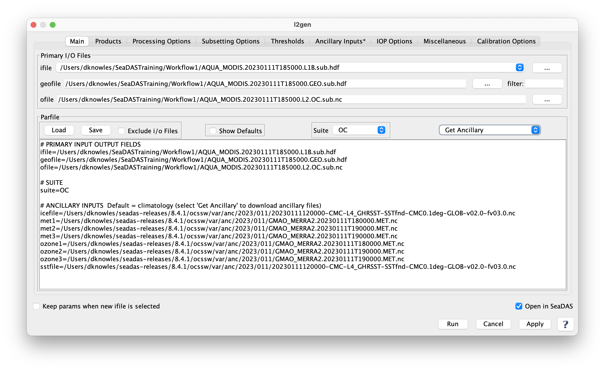
Workflow 1: Create MODIS L2 File (Ancillary files have been loaded)

Slide 52
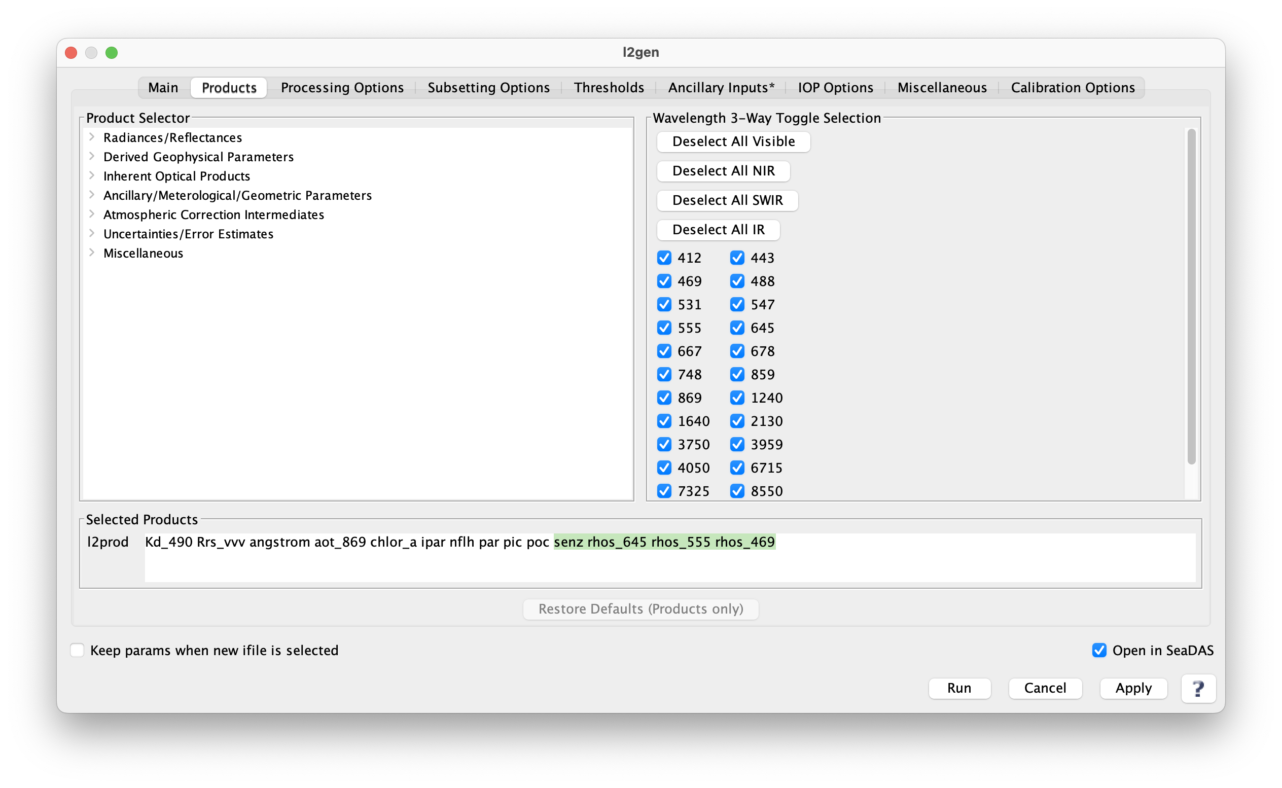
Workflow 1: Create MODIS L2 File (Select some more products)

Slide 53
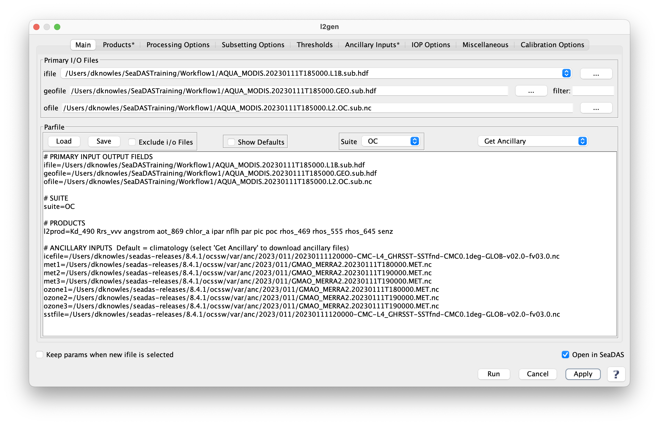
Workflow 1: Create MODIS L2 File (Parameter “l2prod” has been updated)

Slide 54
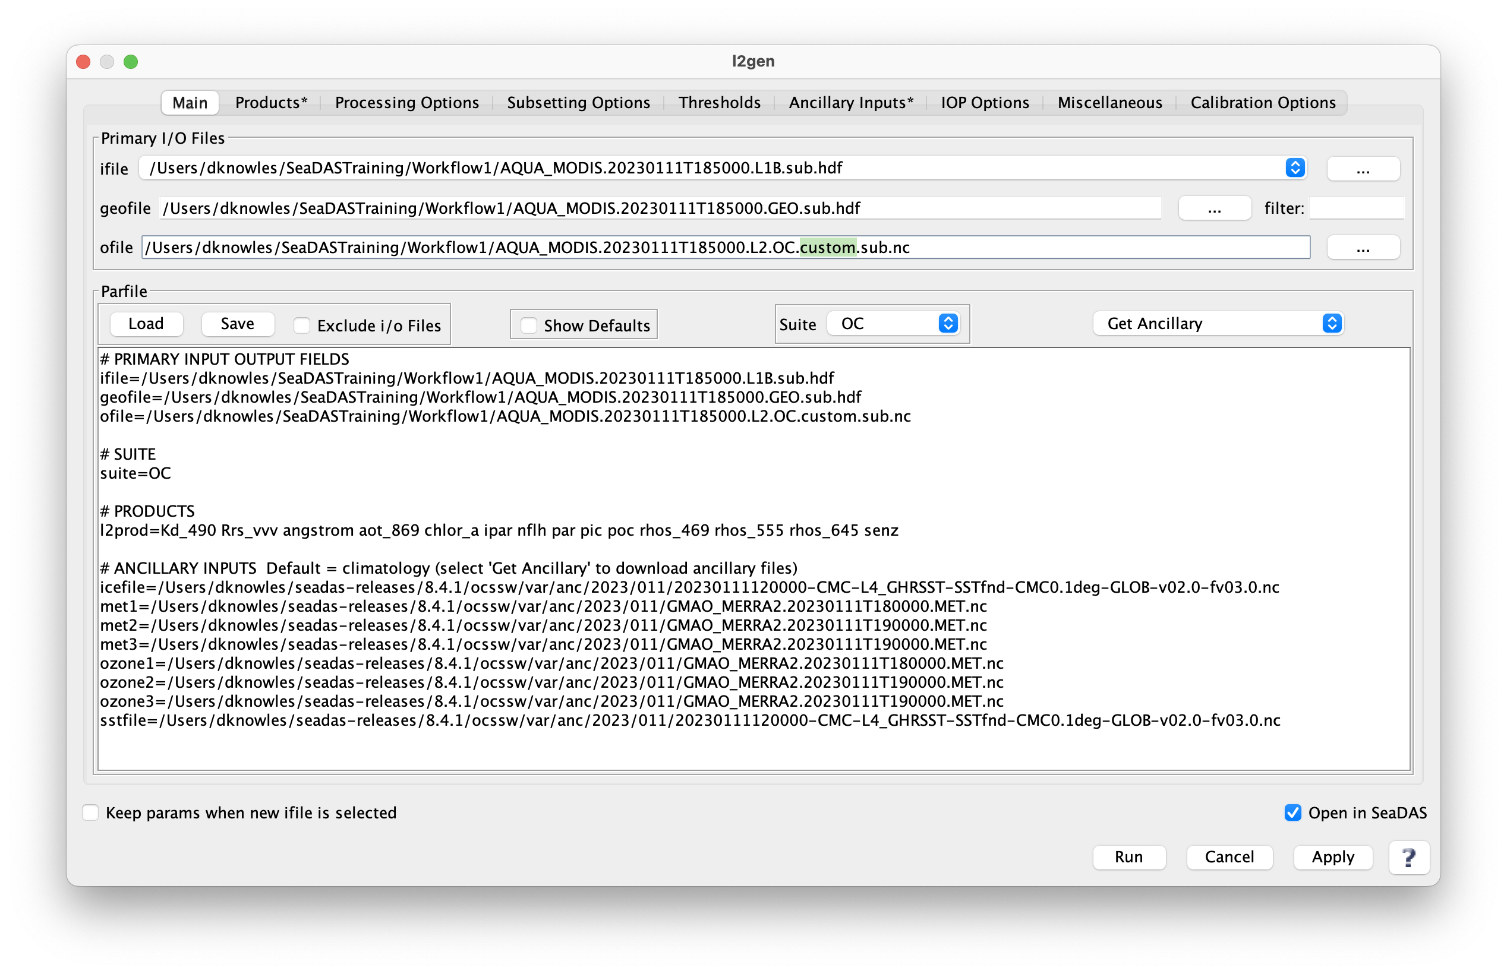
Workflow 1: Create MODIS L2 File (Rename “ofile” and click “Run”)

Slide 55
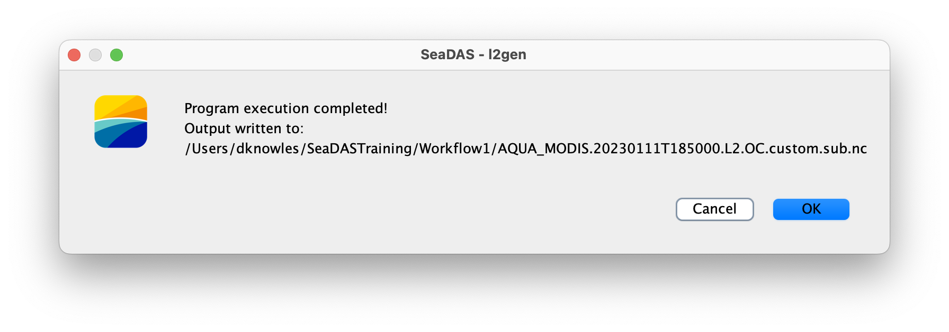
Workflow 1: Create MODIS L2 File (Results message)

Slide 56
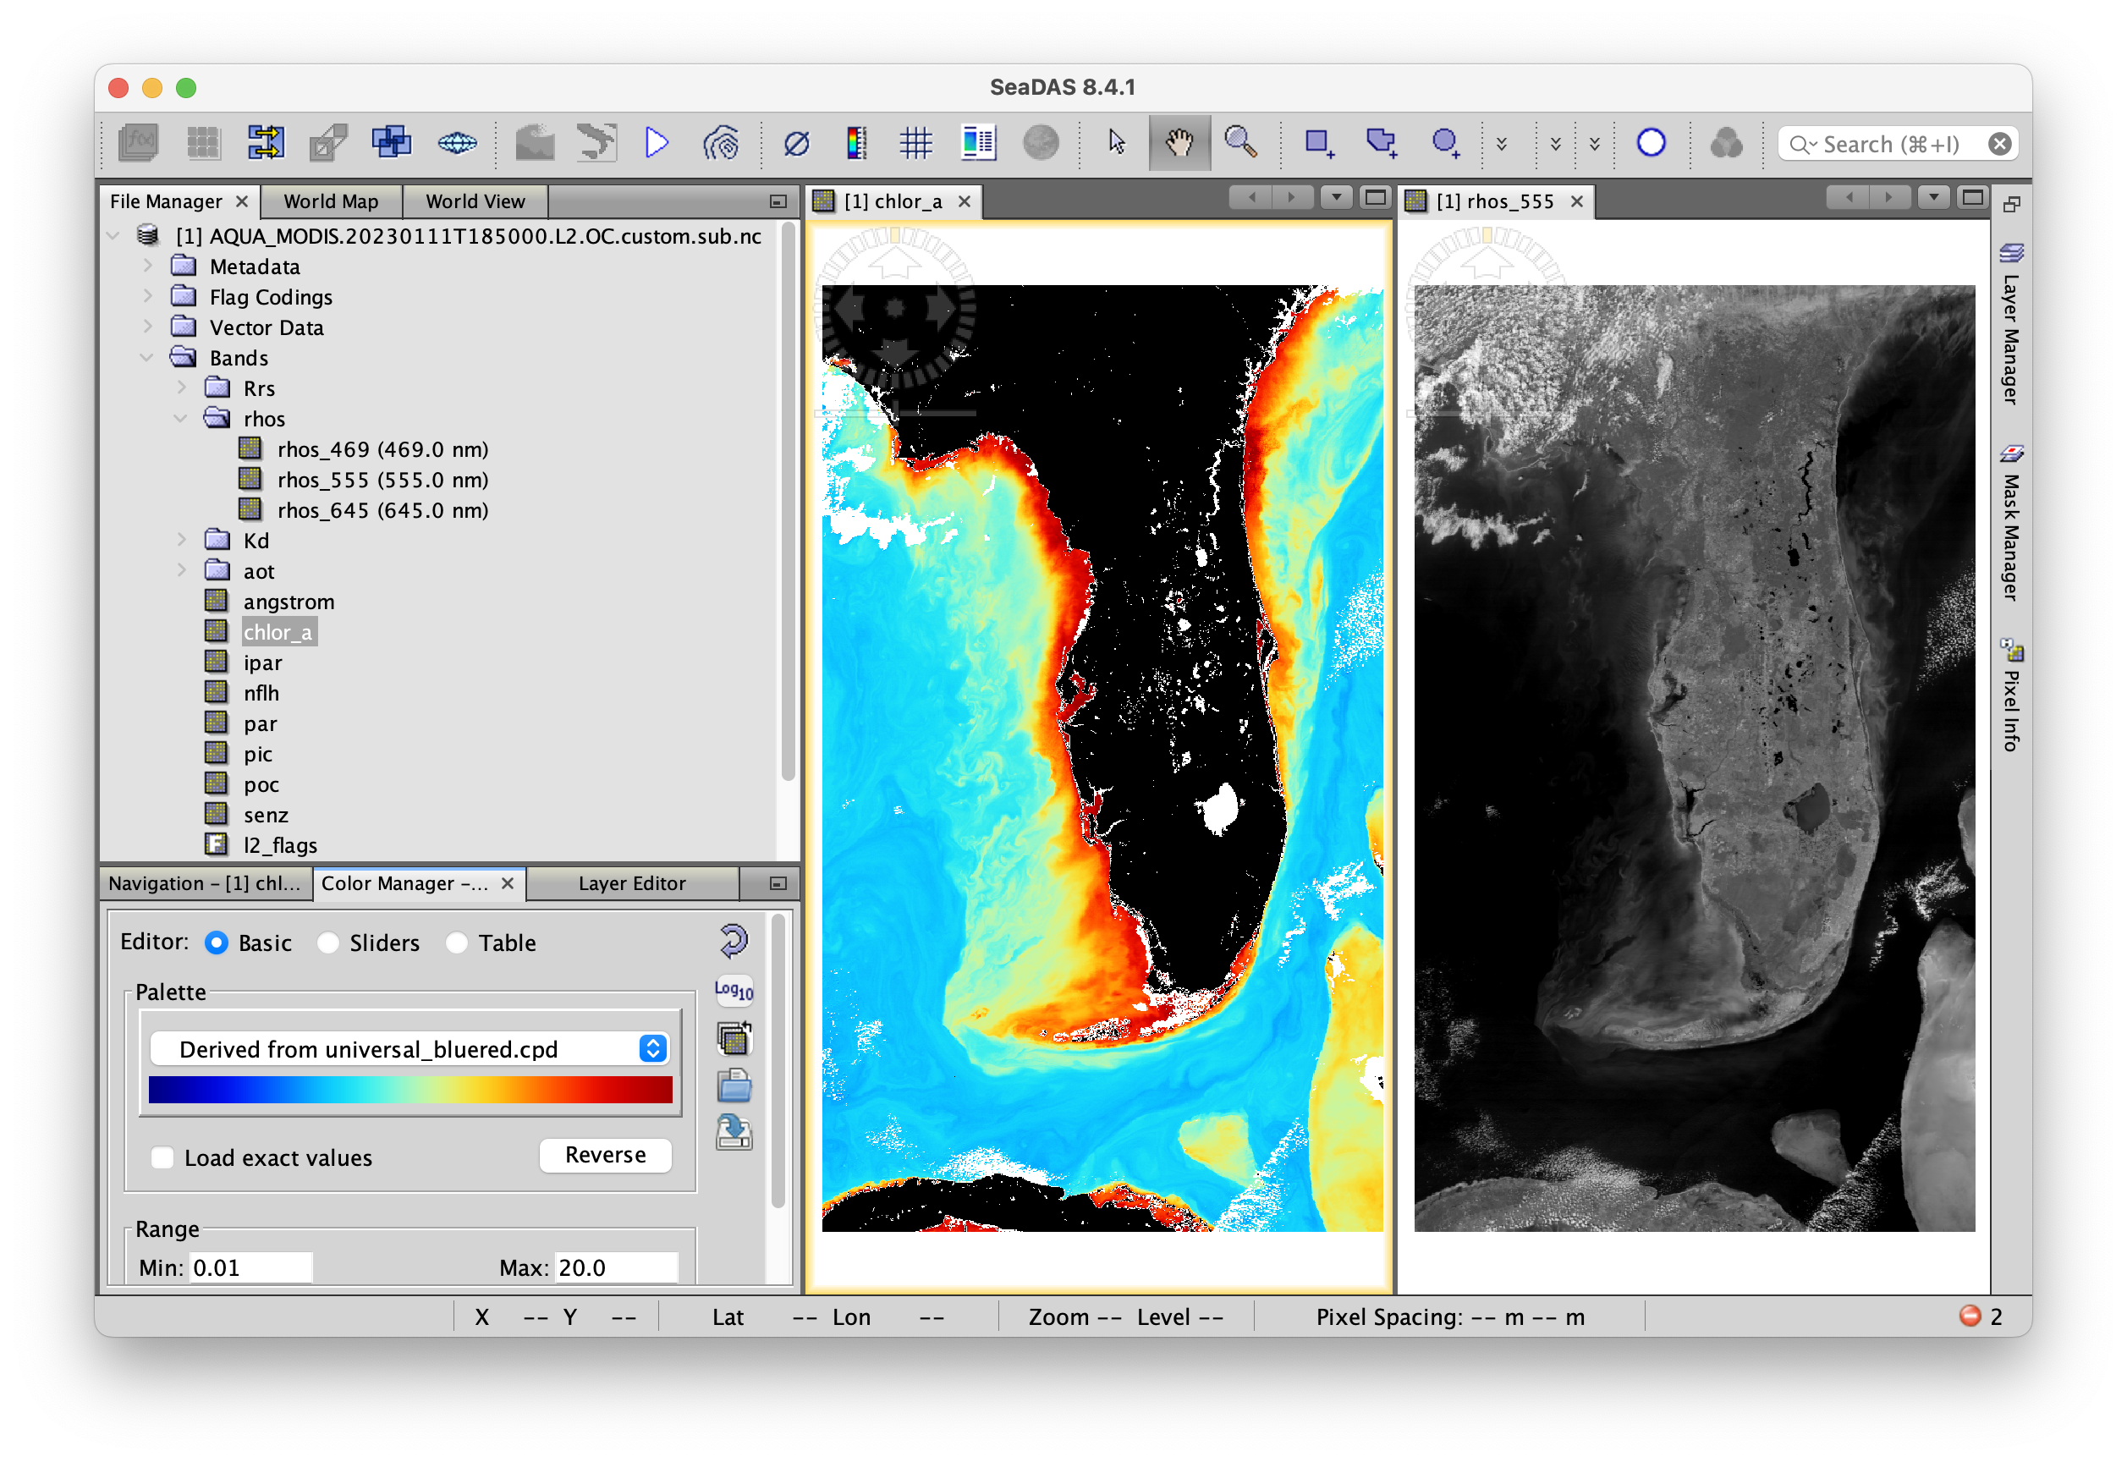
Workflow 1: View the Created MODIS L2 File

Slide 57
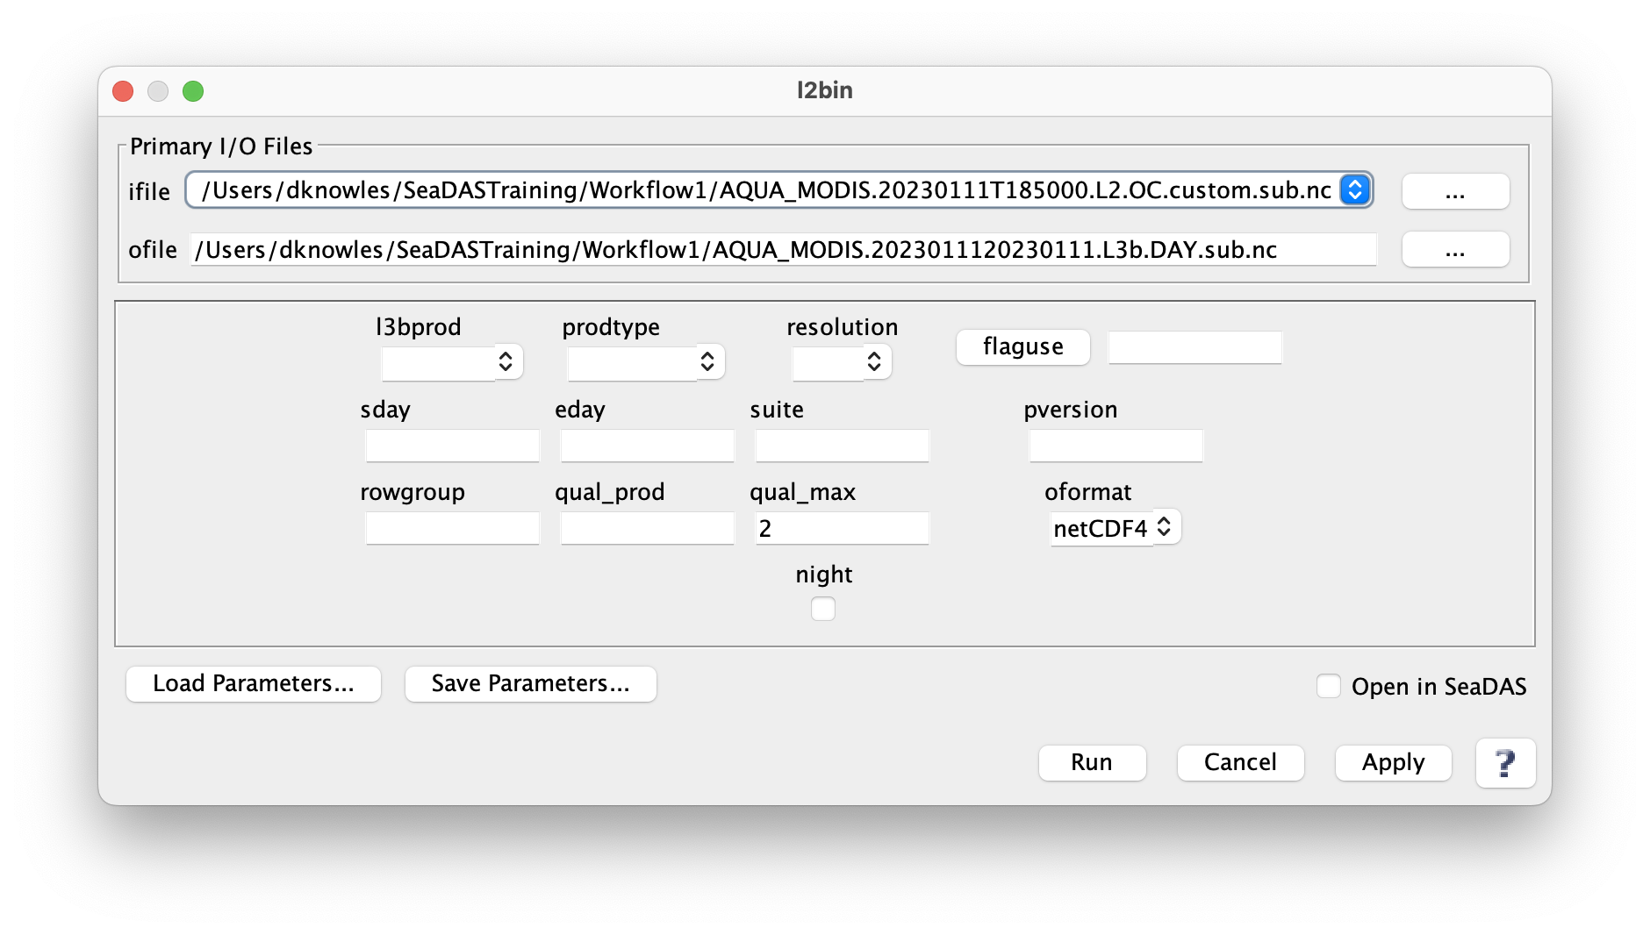
Workflow 1: Create L3 Binned File (Select “ifile”)

Slide 58
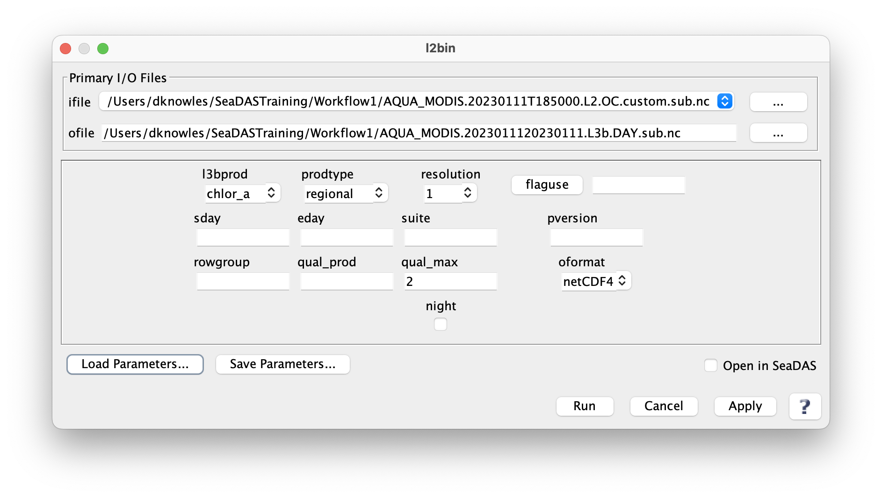
Workflow 1: Create L3 Binned File (Select “l3bprod”, “prodtype”, and “resolution”)

Slide 59
Workflow 1: Create L3 Binned File (Click “flaguse” and specify any desired flags)

Slide 60
Workflow 1: Create L3 Binned File (“flaguse” has been updated)

Slide 61
Workflow 1: Create L3 Binned File (… or select “day” temporal range)

Slide 62
Workflow 1: Create L3 Binned File (… or select custom temporal range and click “Run”)

Slide 63
Workflow 1: Create L3 Binned File (Results message)

Slide 64
Workflow 1: Create L3 Mapped File (Select “ifile”)

Slide 65
Workflow 1: Create L3 Mapped File (Specify “chlor_a” product – … or it can be a product list)

Slide 66
Workflow 1: Create L3 Mapped File (Specify projection – “platecarree” is common for visualization)

Slide 67
Workflow 1: Create L3 Mapped File (Specify projection – …or perhaps “albersconic” for statistics)

Slide 68
Workflow 1: Create L3 Mapped File (Specific resolution – perhaps comparable with bin resolution)

Slide 69
Workflow 1: Create L3 Mapped File (Select interp=“area” to help counteract some missing bins)

Slide 70
Workflow 1: Create L3 Mapped File (Select desired region – else scene is default boundaries)

Slide 71
Workflow 1: Create L3 Mapped File (Specify blend of resolution and fudge to decrease pixelization)

Slide 72
Workflow 1: Create L3 Mapped File (Click “Run”)

Slide 73
Workflow 1: Create L3 Mapped File (Results message)

Slide 74
Workflow 1: View L3 Mapped File alongside L2 File

Slide 75
Workflow 1: multilevel_processor (smi – platecarree)

Slide 76
Workflow 1: multilevel_processor (albersconic)

Slide 77
SeaDAS Workflow: 2
Source files:
S3A_OLCI_EFRNT.20230106T161140.L2.OC.nc
S3A_OLCI_EFRNT.20230106T161440.L2.OC.nc
S3A_OLCI_EFRNT.20230106T161740.L2.OC.nc
S3B_OLCI_EFRNT.20230106T153231.L2.OC.nc
S3B_OLCI_EFRNT.20230106T153531.L2.OC.nc
S3B_OLCI_EFRNT.20230106T153831.L2.OC.nc

Slide 78
Workflow 2: Overview (text file to serve as “ifile” to l2bin)
Text file
Containing list of Level-2 files
l2bin
File: level2_files_OLCI_BOTH.txt
Level-3 Binned File
S3A_OLCI_EFRNT.20230106T161140.L2.OC.nc
S3A_OLCI_EFRNT.20230106T161440.L2.OC.nc
S3A_OLCI_EFRNT.20230106T161740.L2.OC.nc
S3B_OLCI_EFRNT.20230106T153231.L2.OC.nc
S3B_OLCI_EFRNT.20230106T153531.L2.OC.nc
S3B_OLCI_EFRNT.20230106T153831.L2.OC.nc
l3mapgen
Level-3 Mapped File
modis_L1B -o AQUA_MODIS.20230111T185000.L1B.sub.hdf -k AQUA_MODIS_HKM.20230111T185000.L1B.sub.hdf -q AQUA_MODIS_QKM.20230111T185000.L1B.sub.hdf AQUA_MODIS.20230111T185000.L1A.sub AQUA_MODIS.20230111T185000.GEO.sub.hdf

Slide 79
Workflow 2: Create L2 Binned File (Select “ifile”)

Slide 80
Workflow 2: Create L2 Binned File (Specify “l3bprod” and “prodtype”)

Slide 81
Workflow 2: Create L2 Binned File (Specify “resolution=2” – multiscene file could be big)

Slide 82
Workflow 2: Create L2 Binned File (Specify “flaguse” and click “Run”)

Slide 83
Workflow 2: Create L2 Binned File (Results message)

Slide 84
Workflow 2: Create L3 Mapped File (Select “ifile”)

Slide 85
Workflow 2: Create L3 Mapped File (Specify product=chlor_a and resolution=2km)

Slide 86
Workflow 2: Create L3 Mapped File (… or perhaps select projection=“albersconic” for statistics)

Slide 87
Workflow 2: Create L3 Mapped File (Select interp=“area” and click “Run”)

Slide 88
Workflow 2: Create L3 Mapped File (Results message)

Slide 89
Workflow 2: View L3 Mapped File

Slide 90
Workflow 2: View L3 Mapped File (right side image processed at 250m)

Slide 91
Workflow 2: multilevel_processor

Slide 92
SeaDAS Reference Workflows

Slide 93
Creating Level-2 Files: Processing Workflows
MODIS
HawkEye
VIIRS
Level-1A File
modis_L1B
Level-1B File*
l2gen
Level-2 File
modis_GEO
Geo File
Ancillary File
Level-1A File
l2gen
Level-2 File
geolocate_hawkeye
Geo File*
Ancillary File
Level-1A File
l2gen
Level-2 File
geolocate_viirs
Geo File
Ancillary File

Slide 94
Creating Level-2 Files: Processing Workflows
SeaWiFS
CZCS
OLCI
MSI
OLI
GOCI
HICO
MERIS
Level-1A File
l2gen
Level-2 File
Ancillary File
Level-1B File
l2gen
Level-2 File
*OLCI ifile=xfdumanifest.xml
*MSI ifile=manifest.safe
*OLI ifile={filename}_MTL.txt
Ancillary File
* Input files contained in directory with Level-1B file

Slide 95
L3 Binning Workflows (Temporal: l2bin, l3bin)
Combining files with l2bin
Contains flags
Level-2 File
l2bin
Level-3 Bin File
(Composite)
Contains flags
Level-2 File
Combining files later with l3bin
Contains no flags
Flagged data removed
Contains flags
Apply flags
Level-2 File
l2bin
Level-3 Bin File
Contains no flags
Flagged data removed
l3bin
Level-3 Bin File
(Composite)
Contains flags
Apply flags
Level-2 File
l2bin
Level-3 Bin File

Slide 96
L3 Binning Workflows (Temporal: l2bin, l3bin)
Avoid impacts due to uneven temporal distribution of data
Level-3 Binned Files
(DAY)
Level-3 Binned Files
(MONTHLY)
Level-3 Binned Files
(ANNUAL)
Level-2 Files
l2bin
l3bin
l3bin
Apply flags
Bin all level-2 files for each day
Create Level-3 bin file for each month
Create Level-3 bin file for each year

Slide 97
Creating RGB and Product Images: Processing Workflows (mapgen)
OLCI **ifile=xfdumanifest.xml
MSI **ifile=manifest.safe
OLI **ifile={filename}_MTL.txt
GOCI
HICO
MERIS
Flow A:
Flow B:
Flow C:
Flow D:
Level-1B File
mapgen
Image File
Level-1A File
mapgen
Image File
SeaWiFS
CZCS. **ifile=xfdumanifest.xml
Level-1A File
mapgen
Image File
VIIRS
HAWKEYE *
Geo File *
MODIS *
Level-1B File *
mapgen
Image File
Geo File
* Level-1B file (MODIS) and Geo file (HawkEye) not available at NASA OB.DAAC ** Input file contained with Level-1B file directory

Slide 98
SeaDAS Science Processors (Run L2bin from GUI or User Terminal)
L2bin GUI
JAVA API or User Terminal
l2bin par=parfile.par
Level-2 File
L2bin
Executable File
Level-3 Bin File
parfile.par*
ifile=/Users/dknowles/Demo/AQUA_MODIS.20101010T180501.L2.OC.nc
ofile=/Users/dknowles/Demo/AQUA_MODIS.2010101020101010.L3b.DAY.nc
l3bprod=chlor_a
prodtype=regional
resolution=2
*not exact name of file

Slide 99
Miscellaneous Reference Notes

Slide 100
SeaDAS Reference Notes: Adding Custom User Band Lookup Schemes
Edit the following 2 files in the directory ~/.seadas8/auxata/color_schemes/
Note: setting up color scheme lookup for NDVI (next release will be a default)
~/.seadas8/auxdata/color_schemes/color_palette_schemes_user.xml
# Add the following line somewhere between the lines <schemeList> and </schemeList>
<Scheme name="ndvi">
<VERBOSE_NAME/>
<MIN>-0.05</MIN>
<MAX>0.915200</MAX>
<LOG_SCALE>false</LOG_SCALE>
<STANDARD_FILENAME>oceancolor_ndvi.cpd</STANDARD_FILENAME>
<UNIVERSAL_FILENAME>oceancolor_ndvi.cpd</UNIVERSAL_FILENAME>
<COLORBAR_TITLE></COLORBAR_TITLE>
<COLORBAR_LABELS></COLORBAR_LABELS>
<DESCRIPTION>Normalized Difference Vegetation Index</DESCRIPTION>
</Scheme>
~/.seadas8/auxata/color_schemes/color_palette_scheme_lookup_user.xml
# Add the following line somewhere between the lines <colorSchemeLut> and </colorSchemeLut>
<KEY REGEX="^ndvi($|_.+)">
<SCHEME_ID>ndvi</SCHEME_ID>
<DESCRIPTION/>
</KEY>

Slide 101
SeaDAS Reference Notes: Boosting performance (virtual memory issues)

Slide 102
SeaDAS Reference Notes: Boosting performance (virtual memory issues)
Most of these get overridden in the System Performance GUI
(with the exception of snap.dataio.reader.tileWidth and snap.dataio.reader.tileWidth)
${SEADAS_HOME}/etc/snap.properties
# Boost the virtual memory (by factors of gigabyte – adding in increments of 1024)
default_options="--branding snap --locale en_GB -J-Xverify:none -J-Xms512M -J-Xmx7044M -J-Dnetbeans.mainclass=org.esa.snap.main.Main -J-Dsun.java2d.noddraw=true -J-Dsun.awt.nopixfmt=true -J-Dsun.java2d.dpiaware=false"
${SEADAS_HOME}/etc/seadas.conf
# Consider modify these lines
# Tile cache size [Mb]
snap.jai.tileCacheSize=2048
# Default tile size in pixels
snap.jai.defaultTileSize=512
# Reader tile size in pixels
snap.dataio.reader.tileWidth=512
snap.dataio.reader.tileHeight=512
Note:
snap.dataio.reader.tileWidth and snap.dataio.reader.tileWidth
could be temporarily optimized to a particular file shape.

Slide 103
SeaDAS-OCSSW OB.DAAC: True Color Wavelengths
True Color Wavelengths
Mission R G B
GOCI_COMS 660 555 490/412* $OCSSWROOT/share/goci/msl12_sensor_info.dat
HawkEye_SE1** 670 556 488 $OCSSWROOT/share/hawkeye/msl12_sensor_info.dat
MERIS 665 560 490/413* $OCSSWROOT/share/meris/msl12_sensor_info.dat
MODIS_AQUA 645 555 469 $OCSSWROOT/share/modis/aqua/msl12_sensor_info.dat
MODIS_TERRA 645 555 469 $OCSSWROOT/share/modis/terra/msl12_sensor_info.dat
OLCI_S3A 665 560 490/412* $OCSSWROOT/share/olci/s3a/msl12_sensor_info.dat
OLCI_S3B 665 560 490/412* $OCSSWROOT/share/olci/s3b/msl12_sensor_info.dat
OLI_LANDSAT8 655 561 482 $OCSSWROOT/share/oli/msl12_sensor_info.dat
OLI_LANDSAT9 655 561 482 $OCSSWROOT/share/oli/msl12_sensor_info.dat
SeaWiFS_SEASTAR 670 555 490/412* $OCSSWROOT/share/seawifs/msl12_sensor_info.dat
VIIRS NOAA20** 667 556 489 $OCSSWROOT/share/viirs/j1/msl12_sensor_info.dat
VIIRS NOAA21** 667 556 489 $OCSSWROOT/share/viirs/j2/msl12_sensor_info.dat
VIIRS Suomi NPP 671 551 486 $OCSSWROOT/share/viirs/np/msl12_sensor_info.dat
* SFREFL/TC Mapping
** rgb profile configuration file not yet added to SeaDAS (~/.seadas8/auxdata/rgb_profiles)
SeaDAS Supported Missions
AVHRR
CZCS
ETM+ Landsat7
GOCI
HawkEye
HICO
MERIS
MODIS Aqua
MODIS Terra
MOS
MSI Sentinel 2A
MSI Sentinel 2B
OCI PACE**
OCM1
OCM2
OCTS
OLCI Sentinel 3A
OLCI Sentinel 3B
OLI Landsat 8
OLI Landsat 9
OSMI
SeaWiFS
TM Landsat 5
VIIRS Suomi NPP
VIIRS NOAA20
VIIRS NOAA21
Polarimeters:
HARP2 PACE*
MISR
SPEXone PACE*
Airborne Sensors:
AVIRIS
PRISM

Slide 104
SeaDAS: OB.DAAC User Software
SeaDAS Support and Help
Earth Data Forum:
This is where you go to ask questions
https://forum.earthdata.nasa.gov/app.php/tag/SeaDAS
OB.DAAC Website:
This is where you get the Ocean Biology data and SeaDAS
https://www.earthdata.nasa.gov/eosdis/daacs/obdaac
Ocean Color Website:
A direct link to OBPG web site*
https://oceancolor.gsfc.nasa.gov
SeaDAS Website:
A direct link to the SeaDAS web site*
https://seadas.gsfc.nasa.gov
YouTube:
More SeaDAS tutorials planned
https://www.youtube.com/@NASAOceanColor
OB.DAAC
ODPS
User
* Website url subject to change in future

Slide 105
OB.DAAC SeaDAS Team
Aynur Abdurazik – SeaDAS lead developer
Donald Shea - SeaDAS processors lead developer
Daniel Knowles – SeaDAS developer, SeaDAS instruction
Bing Yang – SeaDAS developer, SeaDAS processors developer
Sean Bailey - DAAC Manager
Alicia Scott - Deputy DAAC Manager
Guoqing Wang – DAAC Scientist
OBPG (NASA's Ocean Biology Processing Group) – many scientists and algorithm developers

